Slide 1
Transforming Transportation in Plano

Slide 2
Transportation Division Priorities
Safety
Moving traffic
Reliability
Transparency & user input
Leverage technology & funding
Notes:
Transparency & User Input
Transportation Website
Value User Recommendations & Service Requests
Citizen’s Academy
Leverage Technology
Effective Real-Time Traffic Management
Continuous Improvement

Slide 3
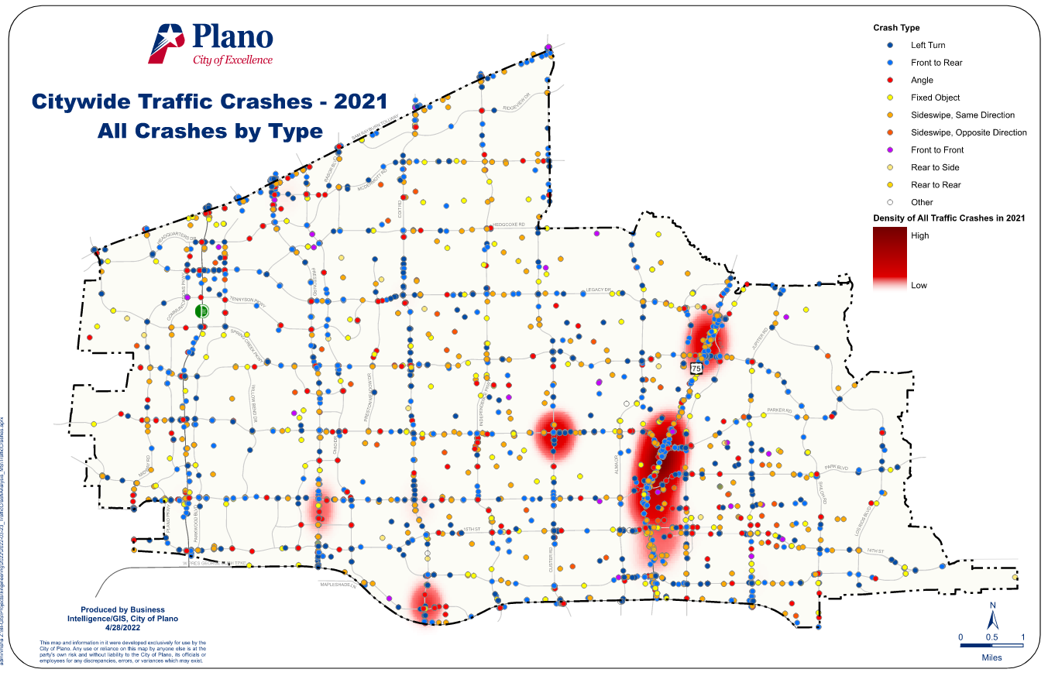
Traffic Safety
Annual HAL/HARS Analysis
Reported crashes of last calendar year
Crash categorization
Location mapping with GIS
Incorporates neighboring cities data
Identifies locations for improvements
Notes:
Requires extensive data clean up
CRIS data is only as good as the cop that wrote the report
Cleaning up location, as well as several other parameters
Recently added unsignalized and midblock analysis
Segregate the highway crashes

Slide 4
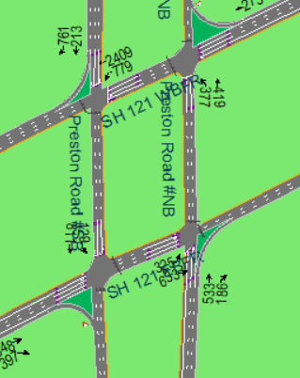
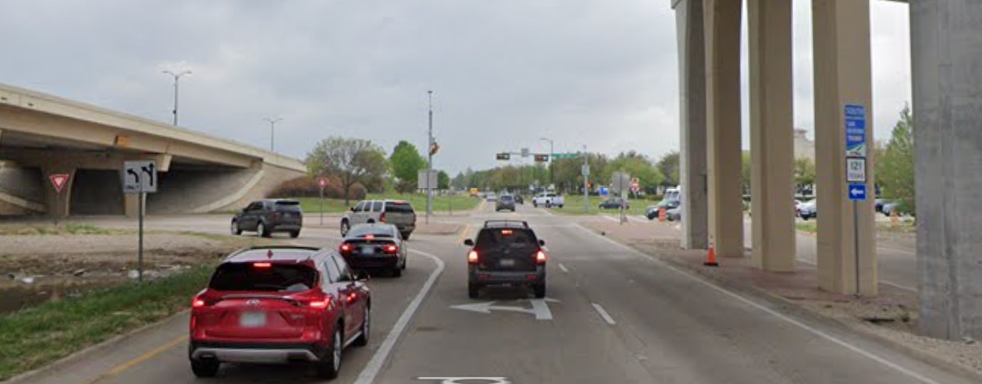
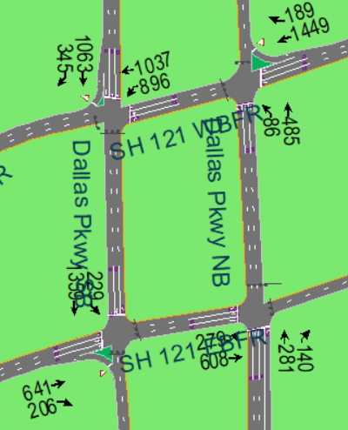
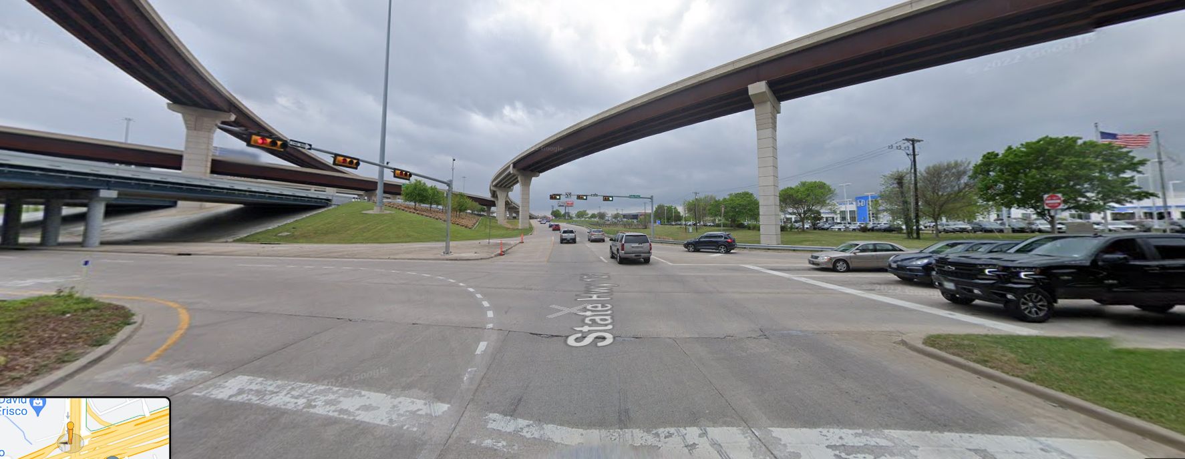
Traffic Safety – Case Study
2 Box Diamonds
Preston Road @ SH 121
Dallas Parkway @ SH 121
Highest crash locations in City
Geometry and signal phasing concerns
Signal timing revised to TTI 4-phase
Interior Crash reduction of over 75%

Slide 5
The Transformation
Emergency Vehicle Preemption System
School Zone Flasher System
LEGEND
- Recently Upgraded System
- Expanding System
- Upgrading System
- Assess New/Upgrade Options
TRAFFIC MANAGEMENT
CENTER**
CCTV System
Communications
System
** - Daily activities include identifying, trouble-shooting, and addressing system problems; developing, implementing, and fine-tuning coordinated traffic signal timing; accident analysis; developing/updating mapping and inventory systems; coordinating with other agencies and City departments; and addressing citizen requests.
Vehicle Detection System
Traffic Signal System
Intersection Traffic Control System
Performance Measurement System
Notes:
Most equipment was over 15 years old.
Master Plan

Slide 6
School Zone Flasher System
Historical Issues
Project Overview
180+ school-zone flashers
Applied Information GLANCE System
Positive command and control
Vendor-hosted Cellular Communication
10-year service contract
Project Cost ~ $630,000
Project Completed 2018
Notes:
Former System
“Dumb” Clocks
Significant Field-crew effort required
Twice a year manual programing
Reliant on Citizen calls when not operating correctly
Funding Source: Traffic Safety Fund (Red Light Camera)

Slide 7
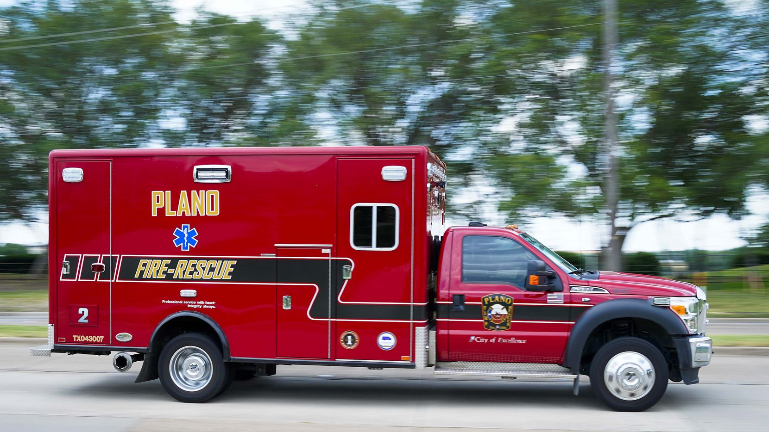
Emergency Preemption
Project Overview
Implement secure coded system
Prevent unauthorized use
Reduce impacts to timing coordination
Upgrade phase selectors
Coordinate with other agencies
Project Benefits
20% reduction in preempt calls
Project Cost ~ $330,000
Project Completed 2020
Notes:
Concern was…
Stealing the green
Upgrade phase selectors to Ethernet
Project cost was largely hardware, but also included a new central software

Slide 8
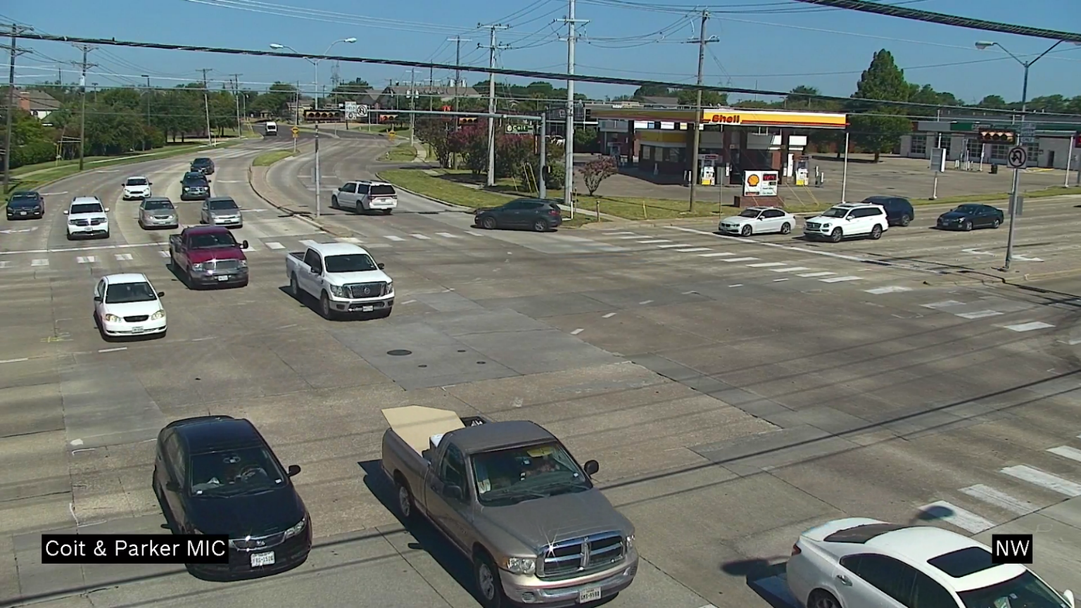
CCTV System
Project Overview
Provide real-time video
Establish data sharing agreements
PS&E design by consultant
Construction by contractor
Total Estimated Cost ~ $3.3M
Project Completion ~ 2024
Notes:
2 different projects for funding
44 cameras existing
160 cameras with first project design is almost done
80 cameras with next project this design contract hasn’t been executed yet.

Slide 9
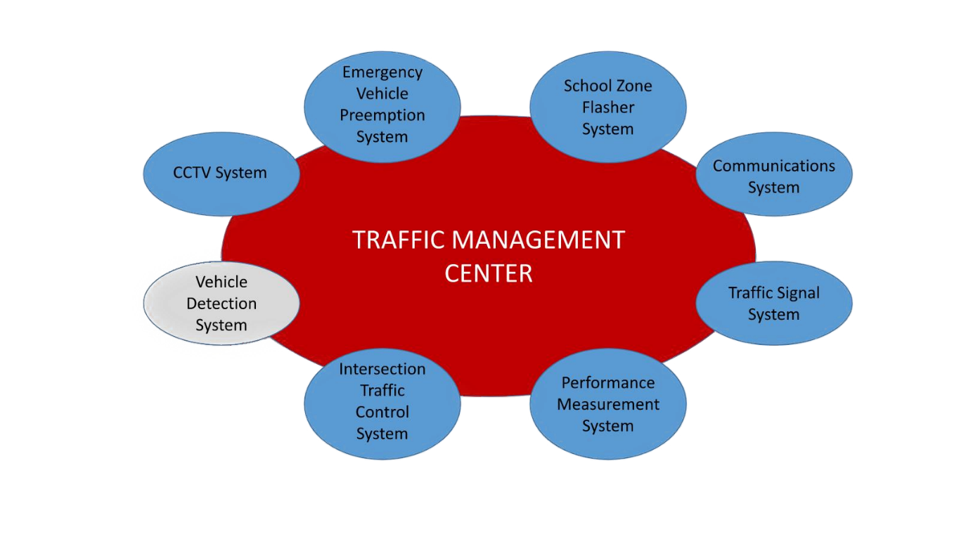
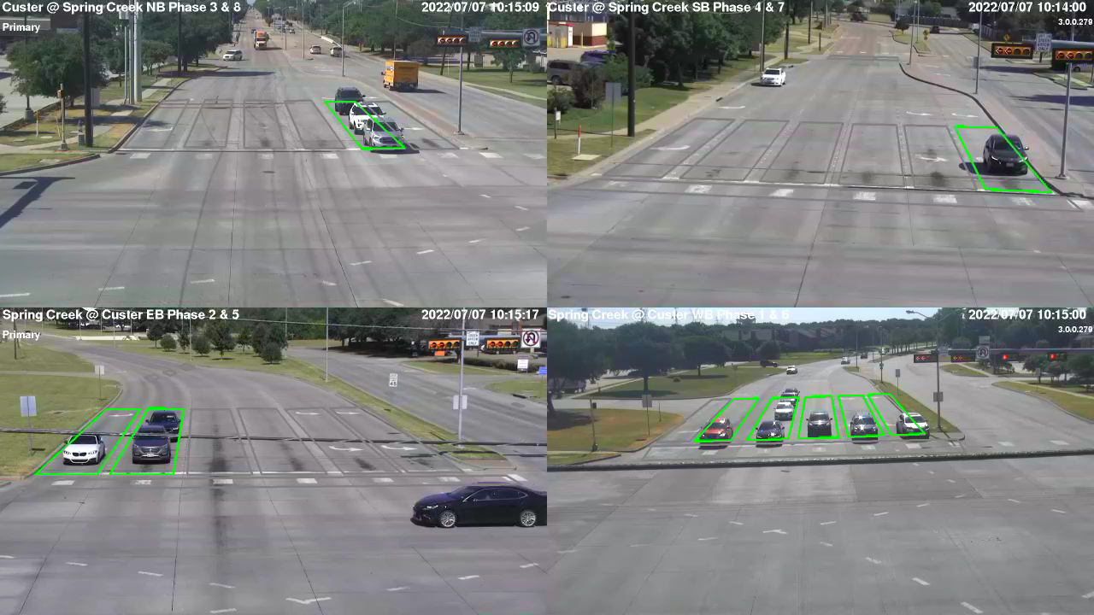
Vehicle Detection System
Historical Issues
Project Objectives
Develop reliable vehicle detection toolbox
Support high resolution data
Provide ATSPM/Purdue functionality
Provide live video feeds to TMC
Allow real-time adjustment to detection
Spec Development by Consultant
Detection Programming by City staff
Estimated Cost ~ $8.3M
Project Completion ~ 2024
Notes:
VIVDS system is largely autoscope solopro analog has reached end of life.
Frankenstien maintenance at this point
Trafficware Pods were installed as a pilot adaptive system and those were a total failure
Issues with Video Detection we get a lot of false calls and dropped called

Slide 10
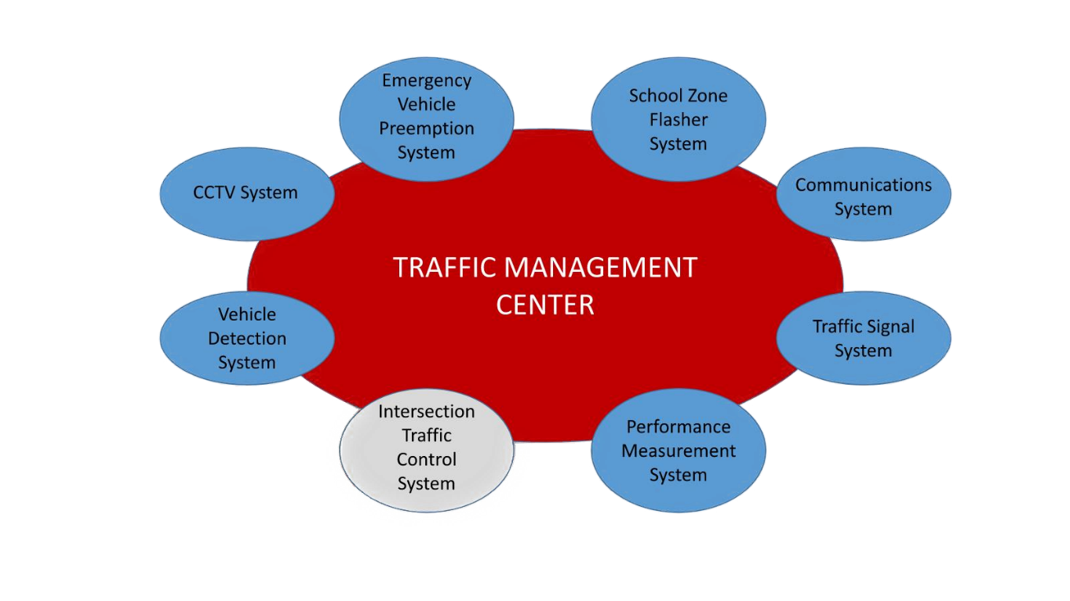
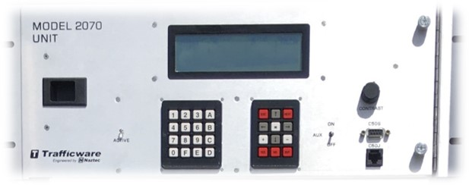
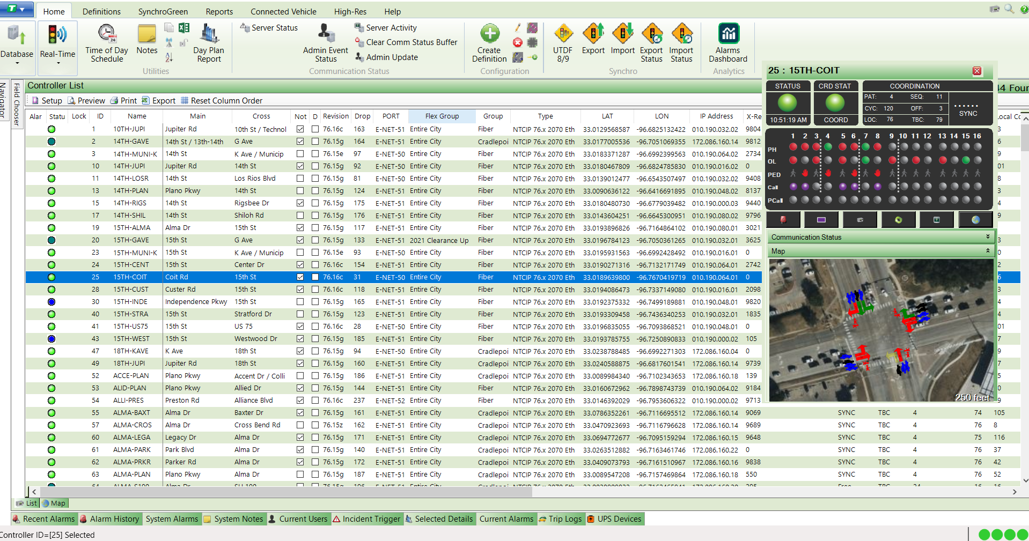
Intersection Traffic Control System
EXISTING SYSTEM
CalTrans 332 cabinets
TrafficWare 2070 controllers
Autoscope VIVDS
GTT IR Opticom with central monitoring
ATMS.now central system
Limited CCTV coverage
100% ethernet communication
Cradlepoint LTE 55%
City-Owned Fiber Network 45%
97%+ uptime
Notes:
CalTrans 332 cabinets
Limited 20-channel cabinets
Limited BBU coverage

Slide 11
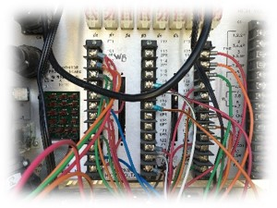
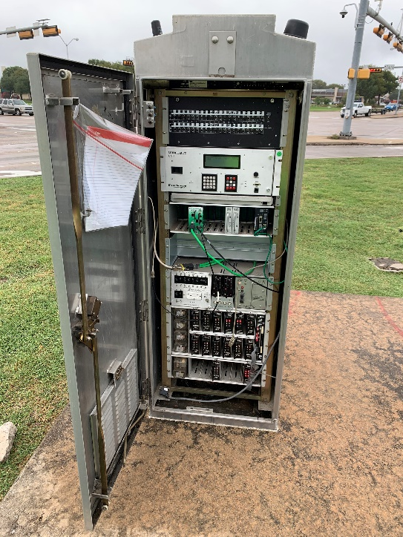
Intersection Traffic Control System
Project Overview
Develop new City standard:
Local controller software
Local controller hardware
ATC traffic cabinets
New central management system
Allow for improved phasing/timing plans
Modernized equipment
Spec development by consultant
Implementation and deployment largely by City forces
Estimated Cost ~ $7.4M
Estimated Completion ~ 2024

Slide 12
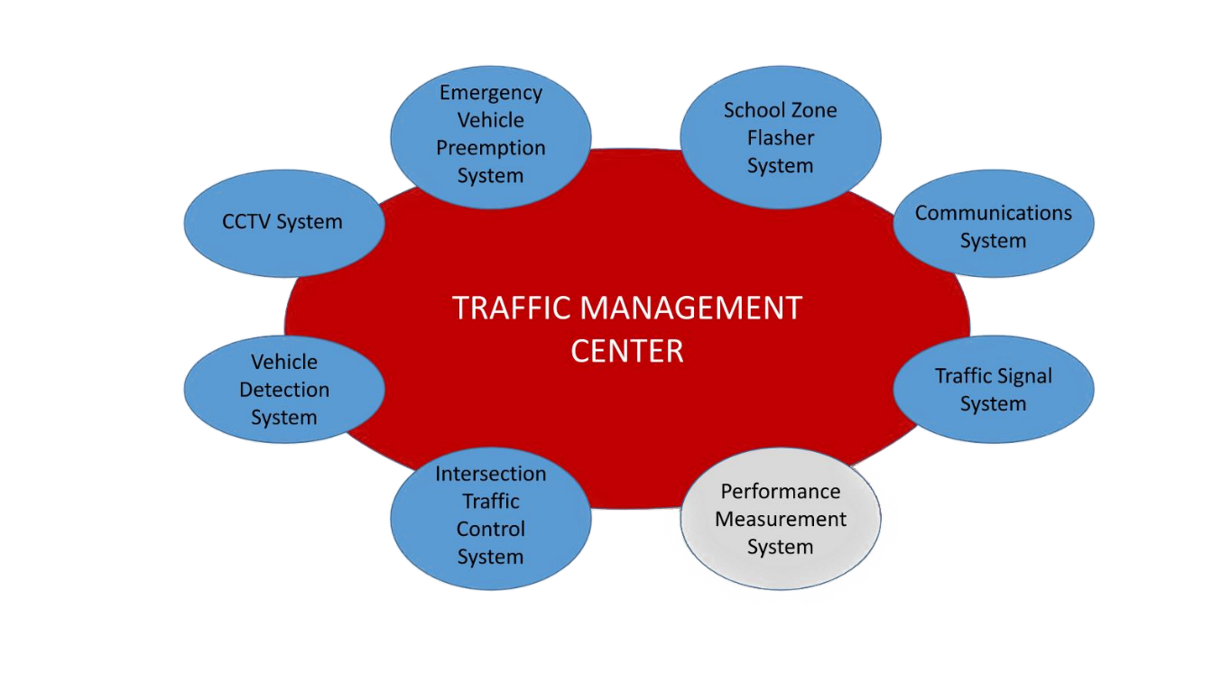
Performance Measurement System
Project Overview
New central system software
Real time ATSPM reporting
Real time timing adjustments
Collect real time traffic counts
Specifications by consultant
Implementation and maintenance by City staff
Estimated Cost ~ $1.2M
Project Completion ~ 2025

Slide 13
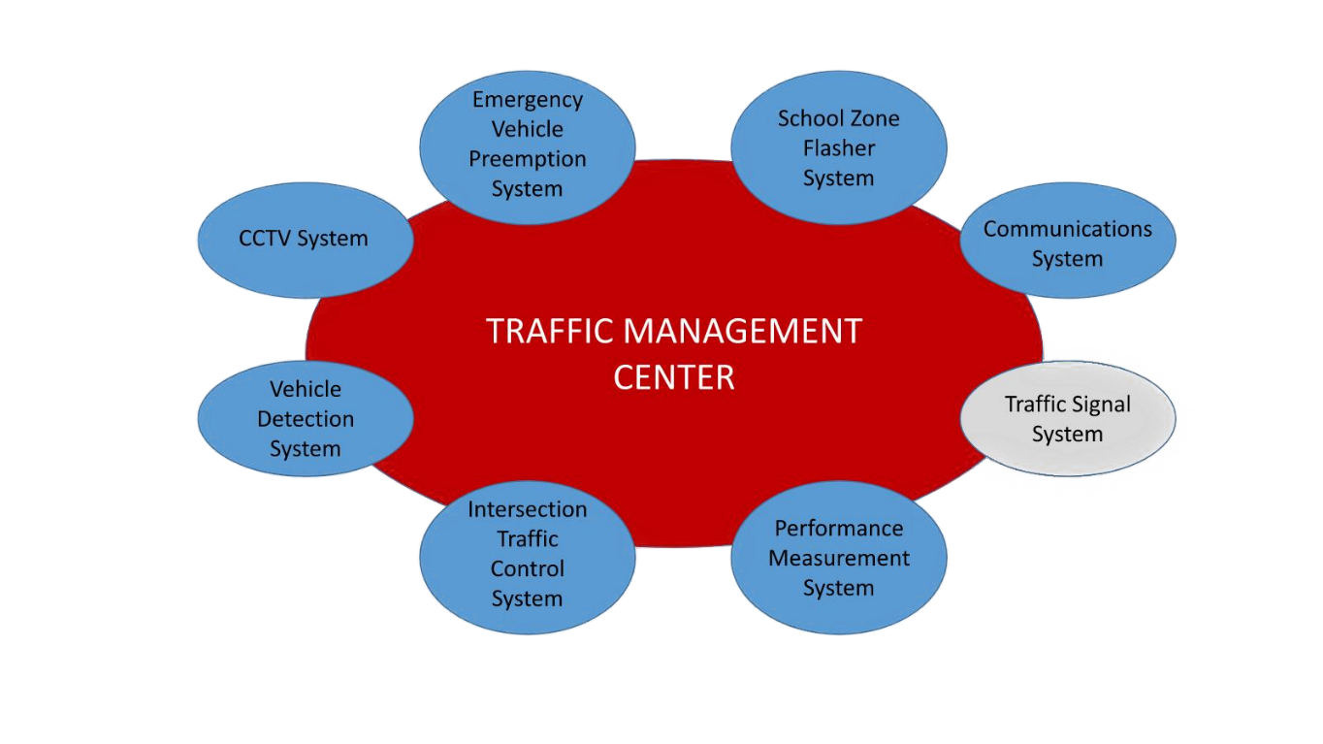
New Traffic Signals
Project Overview
10 new traffic signals under design
City consultant designing 8 signals
Private developer installing 2 signals
Estimated Cost ~ $2.8M
Project Completion 2022-2023

Slide 14
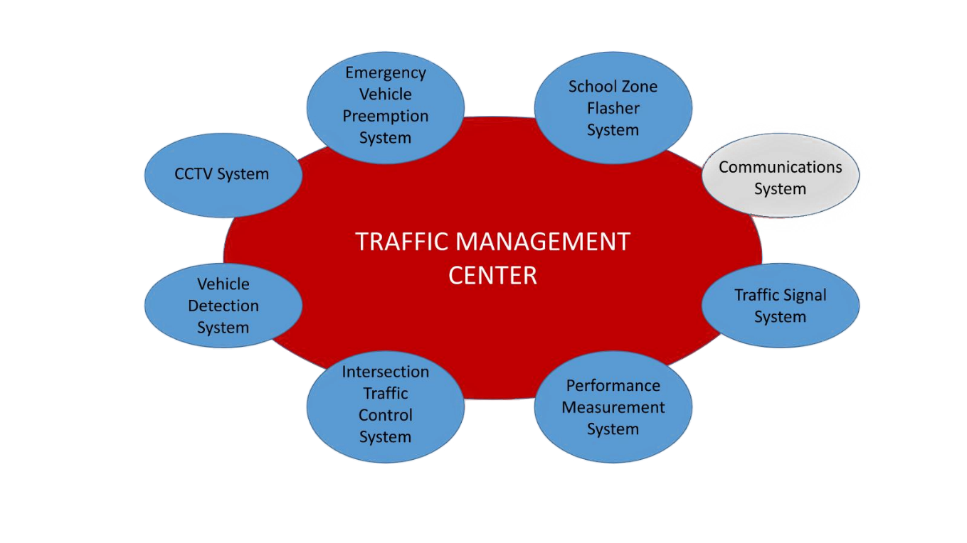
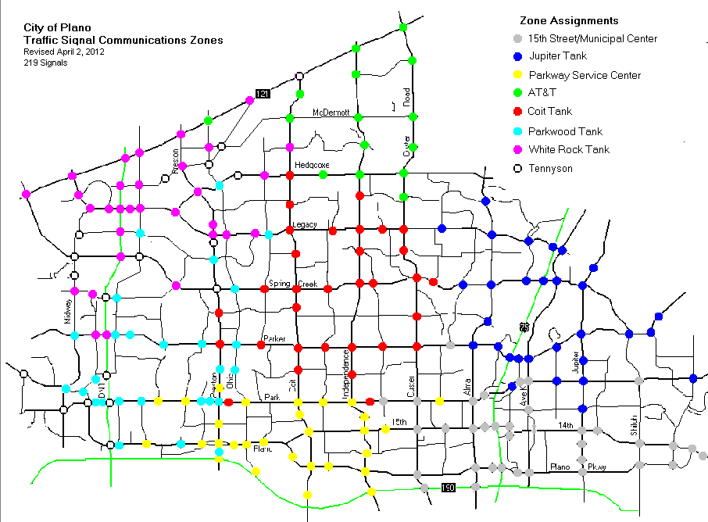
Communications System History
CATV - Analog (Pre 2000)
900 MHz Spread Spectrum Radio (2000-2016)
Wireless MotoMesh Network (2014-2020)
Notes:
CATV - Analog (Pre 2000)
Supported analog PTZ Cameras
B-Side Plant decommissioned by Cable Company
900 MHz Spread Spectrum Radio (2000-2016)
Repeaters on water towers, City hall, and a leased AT&T tower
Limited Bandwidth, No CCTV support
Line of Sight Issues
Wireless MotoMesh Network (2014-2020)
Ethernet connectivity
Limited Bandwidth, Poor Performance
Line of Sight Issues
Cradlepoint 4G LTE (2015-Future)
Fiber Network (2019-Future)

Slide 15
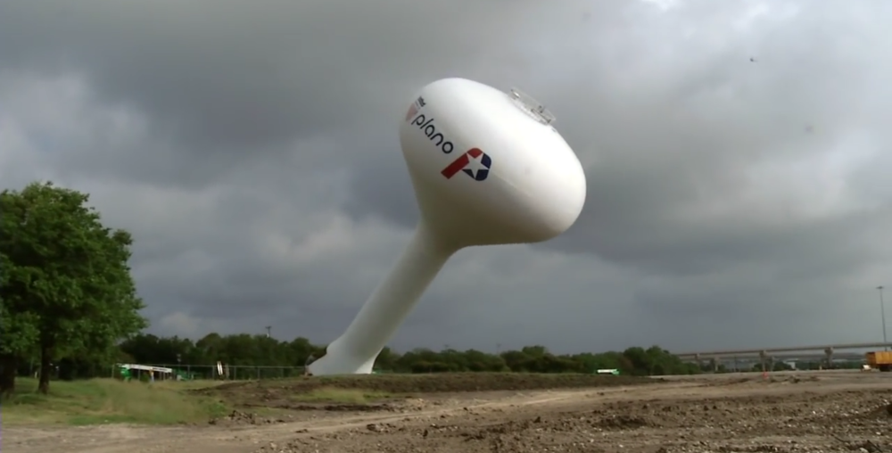
Communications System History
CATV - Analog (Pre 2000)
900 MHz Spread Spectrum Radio (2000-2016)
Wireless MotoMesh Network (2014-2020)
Cradlepoint 4G LTE (2015-Future)
Fiber Network (2019-Future)
Notes:
CATV - Analog (Pre 2000)
Supported analog PTZ Cameras
B-Side Plant decommissioned by Cable Company
900 MHz Spread Spectrum Radio (2000-2016)
Repeaters on water towers, City hall, and a leased AT&T tower
Limited Bandwidth, No CCTV support
Line of Sight Issues
Wireless MotoMesh Network (2014-2020)
Ethernet connectivity
Limited Bandwidth, Poor Performance
Line of Sight Issues
Cradlepoint 4G LTE (2015-Future)
Fiber Network (2019-Future)

Slide 16
Communications System Upgrades
Project Overview
Connect majority of network to City fiber
Inter-local sharing agreements
Maintain >97% uptime
PS&E design by consultants
Construction by contractor
Estimated Cost ~ $4.9M
Project Completion ~ 2025
Notes:
Adds another 110 signals to the network

Slide 17
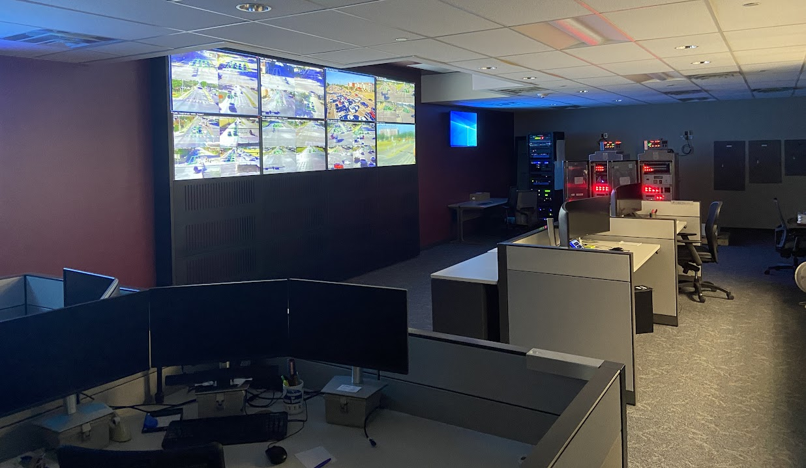
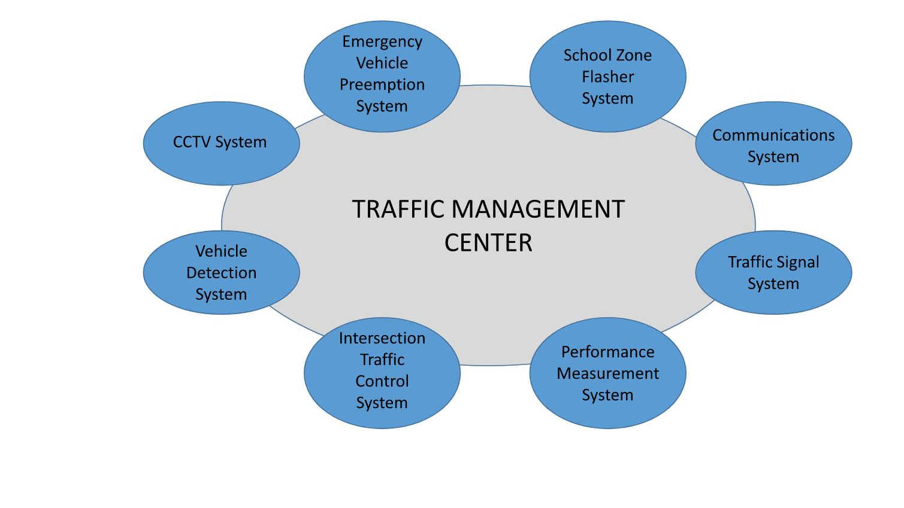
Traffic Management Center
Estimated Cost ~ $457,000
Estimated Completion Date ~ Late Fall 2022
Notes:
Supply chain issues
Substantially complete

Slide 18
Other Projects
DART Silver Line
Coordination
Railroad preemption
Thoroughfare standards update
Traffic calming
City wayfinding
System wide signal retiming
CIP intersection improvements
Minor traffic operations improvements
Notes:
TIA requirements and Loopholes to thoroughfare standards
Intersection improvements informed by HAL HARS

Slide 19
Funding Sources
CIP (City Bond Funding) $29,572,000
Federal – CMAQ $2,269,000
Federal – ARPA $9,800,000
Red Light Running Funds $1,417,000
Total Funds Allocated $43,058,000
Notes:
CMAQ – CCTV and a few signal cabinets
ARPA – Vehicle Detection and Wayfinding
Red Light Funds – TMC, Opticom, School Zone Flashers

Slide 20
Engineering Opportunities
Open positions: Plano.gov/Jobs
Senior Traffic Engineer / Traffic Engineer (PE)
Senior Transportation Technician (TMC Operator)
Existing consultant contracts
$3.7M contracted consultant fees 2019 – Present
10 different firms over 18 projects
Future consultant contracts
At least $2.5M in planned traffic engineering contracts
RFQ for on-call services late summer 2022

Slide 21
Questions
Matt Tilke
mtilke@plano.gov
972-941-5765
Chad Ostrander
costrander@plano.gov
972-941-5341

