Slide 1
Wrong Way Driving Systems Best Practices
Gaby Tassin, P.E., PTOE, PTP, RSP
Jacob Sessions, P.E.

Slide 2
SAFETY MOMENT

Slide 3
AGENDA
?
WWD Process
Examples:
Challenges/
Solutions
Transportation
System
Management
Questions

Slide 4
WWD PS&E Process
Notes:
Step 1 - Conduct a meeting with NTTA to understand wrong way drive (WWD) needs and expectations.
Identify any unique operational characteristics. Our teams’ knowledge of the existing NTTA system (unique characteristics):
NTTA maintains existing FLIR sensors within the mainlanes systemwide. These FLIR sensors are used for detecting traffic movements in real-time.
TAPCO recently installed additional sensors at ramps to work in tandem with the mainlane sensors.
Discuss NTTA design preferences (FOC sizing, home runs vs. splicing, pigtails or direct to cabinet, tracer wire sizing, conduit size preferences, ground box preferences, etc.) to help in the development of the PS&E plan sets.
Step 2 - Review existing ITS infrastructure availability and locations.
Coordination with existing ITS devices.
Fiber optic cable and/or wireless communications.
Gap analysis, if any.
Step 3 - Review corridor and identify WWD locations.
Identify location constraints, such as horizontal and vertical sight distance concerns, terrain analysis, ROW constraints, clear zone requirements.
Identify locations that may benefit from additional sensors and/or signage due to constraints.
Identify potential power service source locations and/or identify the potential need for solar-powered locations.
Our teams’ knowledge of the existing NTTA system (unique characteristics):
NTTA utilizes the lower mounted signs and light bars (instead of LED strip around sign edge).
Create an ITS report that includes field data review, detection and warning system technology review, system design review, recommended strategies, and proposed design guidelines.
Step 4 - Conduct meeting(s) with WWD system provider to work through constraints and ensure compatibility with existing NTTA systems. Our teams’ knowledge of the existing NTTA system (unique characteristics):
NTTA utilizes the FLUX alert management software instead of TAPCO’s BlinkLink software. Several conversations have been had about using THE TAPCO system since it has a lower latency for data and supports a larger video packet than the FLUX system. However, the FLUX system is already in place and was very expensive for NTTA. As a result, the odds of changing are very low.
Step 5 - PS&E design process.
Provide layout of WWD system with power service locations and communications connection infrastructure.
Plan sets will include details such as quantities, project layout, electrical service details, system layout sheets, fiber schematic, warning system infrastructure, warning signs, pavement markings, ITS cabinets, proposed CCTV cameras,
Through the 30, 60, 90, 100 design process, WWD system locations will be refined to meet the specific location needs as well as to adapt to the corridor-wide ITS needs. These can include:
Crests of curves
Horizontal/vertical curve issues
Meeting Clear Zone requirements as defined in the AASHTO Roadside Design Guide.
Awareness of queue lengths that may result in false readings.
The proximity between driveways along the frontage road and the ramps (locations where there is a higher potential for WWD.
Review plans to ensure ease of maintenance and safety of staff during construction.

Slide 5
STEP 1 Conduct a Meeting with Client to understand WWD Needs & Expectations
Identify any unique operational characteristics
Detection equipment wants
Desired point of alert detection
Level of automation
Discuss client design preferences to help in the development of the PS&E plan sets.
FOC sizing
home runs vs. splicing
pigtails or direct to cabinet
tracer wire sizing
conduit size
ground box preferences, etc.
30, 60, 90, 100% expectations
Notes:
Unique operational characteristic
Detection equipment wants

Slide 6
STEP 2 Review existing ITS infrastructure availability and locations
Review existing ITS infrastructure availability and locations:
Coordination with existing ITS devices.
Fiber optic cable and/or wireless communications.
Gap analysis
Potential for upgrades
Notes:
Step 2 - Review existing ITS infrastructure availability and locations.
Coordination with existing ITS devices.
Fiber optic cable and/or wireless communications.
Gap analysis, if any.
Step 3 - Review corridor and identify WWD locations.
Identify location constraints, such as horizontal and vertical sight distance concerns, terrain analysis, ROW constraints, clear zone requirements.
Identify locations that may benefit from additional sensors and/or signage due to constraints.
Identify potential power service source locations and/or identify the potential need for solar-powered locations.
Our teams’ knowledge of the existing NTTA system (unique characteristics):
NTTA utilizes the lower mounted signs and light bars (instead of LED strip around sign edge).
Create an ITS report that includes field data review, detection and warning system technology review, system design review, recommended strategies, and proposed design guidelines.
Step 4 - Conduct meeting(s) with WWD system provider to work through constraints and ensure compatibility with existing NTTA systems. Our teams’ knowledge of the existing NTTA system (unique characteristics):
NTTA utilizes the FLUX alert management software instead of TAPCO’s BlinkLink software. Several conversations have been had about using THE TAPCO system since it has a lower latency for data and supports a larger video packet than the FLUX system. However, the FLUX system is already in place and was very expensive for NTTA. As a result, the odds of changing are very low.
Step 5 - PS&E design process.
Provide layout of WWD system with power service locations and communications connection infrastructure.
Plan sets will include details such as quantities, project layout, electrical service details, system layout sheets, fiber schematic, warning system infrastructure, warning signs, pavement markings, ITS cabinets, proposed CCTV cameras,
Through the 30, 60, 90, 100 design process, WWD system locations will be refined to meet the specific location needs as well as to adapt to the corridor-wide ITS needs. These can include:
Crests of curves
Horizontal/vertical curve issues
Meeting Clear Zone requirements as defined in the AASHTO Roadside Design Guide.
Awareness of queue lengths that may result in false readings.
The proximity between driveways along the frontage road and the ramps (locations where there is a higher potential for WWD.
Review plans to ensure ease of maintenance and safety of staff during construction.

Slide 7
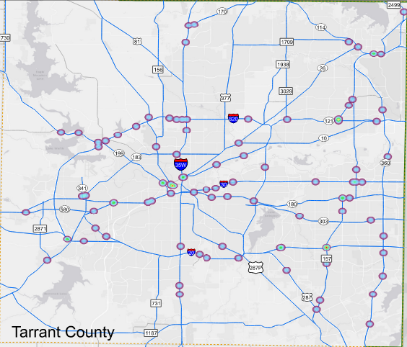
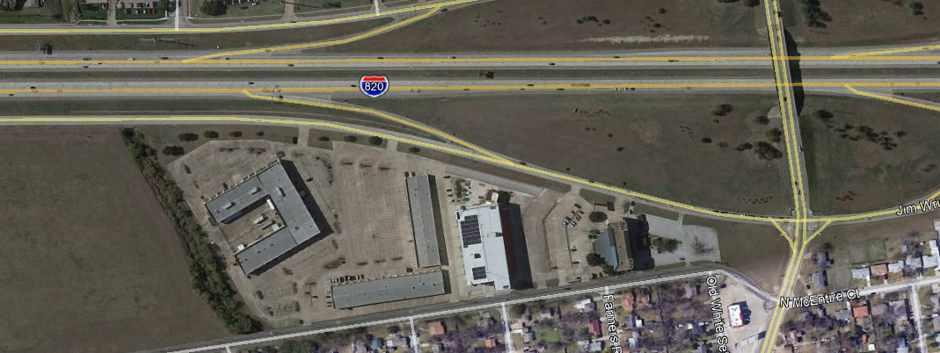
STEP 3 Review corridor and identify WWD Locations
Crash record analysis
Identify location constraints
Identify locations that may benefit from additional sensors and/or signage due to constraints
Identify potential power service source locations and/or potential need for solar-powered locations
Identify local land use to identify potential contributors
Create an ITS report
Notes:
Location constraints:
horizontal and vertical sight distance concerns,
terrain analysis,
ROW constraints,
clear zone requirements,
local access driveways,
radar interference.
ITS report that includes:
field data review, detection and warning system technology review, system design review, recommended strategies, and proposed design guidelines.

Slide 8
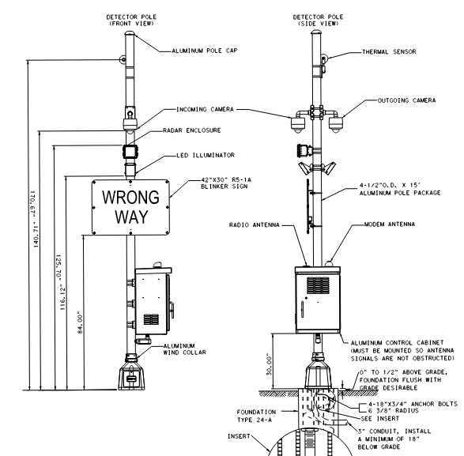
STEP 4 Conduct meeting(s) with WWD system provider
Discuss alert management software being used
Identify detection equipment utilized
Radar, Lidar, Video, etc.
Discuss equipment constraints and needs
Power requirements
Communication needs
Alert latency
Detection & Verification device zone limits

Slide 9
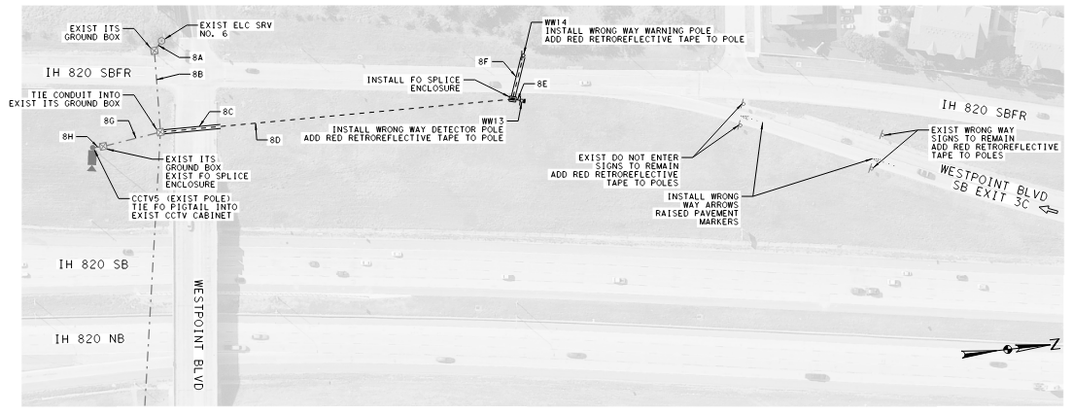
STEP 5 PS&E Design Process
Provide layout of WWD system
Refined to meet the specific location needs as well as to adapt to the corridor-wide ITS needs.
Review plans to ensure ease of maintenance and safety of staff during construction.
Notes:
Step 5 - PS&E design process.
Provide layout of WWD system with power service locations and communications connection infrastructure.
Plan sets will include details such as quantities, project layout, electrical service details, system layout sheets, fiber schematic, warning system infrastructure, warning signs, pavement markings, ITS cabinets, proposed CCTV cameras,
Through the 30, 60, 90, 100 design process, WWD system locations will be refined to meet the specific location needs as well as to adapt to the corridor-wide ITS needs. These can include:
Crests of curves
Horizontal/vertical curve issues
Meeting Clear Zone requirements as defined in the AASHTO Roadside Design Guide.
Awareness of queue lengths that may result in false readings.
The proximity between driveways along the frontage road and the ramps (locations where there is a higher potential for WWD.
Review plans to ensure ease of maintenance and safety of staff during construction.

Slide 10
CHALLENGES/SOLUTIONS IH 820 Implementation & Design WWD System
Challenge #1: Detect vehicles prior to entering the ramp.
Challenge # 2: Address Horizontal Curve Issues.
Challenge # 3: Reduce “False Calls” from the WWD equipment.
Notes:
Challenge: Detect vehicles along Frontage road to detect WWD prior to them entering the ramps.
Solution: Placed WWD in the frontage road and spoke with TAPCO to ensure that the radar detector could detect vehicle in the far lane (3rd lane) 100-200 ft before the physical gore because the radar can determine if the vehicle will be going on the ramp or stay on the frontage road. Placed detectors away from the intersection queues.
Benefit: Were able to mitigate horizontal curve issues. It was a sight line issue.

Slide 11
Notes:
Challenge: Reduce “false calls” from the WWD equipment.
Solution: Our team collaborated with the WWD equipment vendor, TAPCO, to ensure the optimum placement of the detectors by taking into account queue lengths from nearby signalized intersections that caused false calls.

Slide 12
CHALLENGES/SOLUTIONS Post Oak at Westpark Toll Road
Post Oak
Challenge #1: Tight geometric configuration at the intersection -detect vehicles prior to entering the ramp.
Challenge # 2: Address Horizontal & Vertical Curve Issues.
Challenge #3: In 2011, no proven available technology for WWD.
Richmond Ave
Notes:
Implemented a system that had not been used in Texas or USA.
Piucks were for vehicular detection for traffic signals. But they can also determine direction of flow, if placed in a certain pattern.
We knew it was effective but no maintenance. In 2011, IT WAS A great solution
Pull out the pucks to change the batteries.
Solution: investigate new technology (pucks), that could determine if someone is going the wrong way.
Queue did NOT cause issues with the

Slide 13
Post Oak
Richmond Ave
IH 69
Westpark Toll Road
IH 610

Slide 14
DON’T FORGET!
Transportation System Management – low cost improvements
Notes:
Challenge: Identify locations most prone to wrong way driving.
Solution: Visited the field to confirm location of driveways with proximity to the ramps. In addition, identified low-cost improvements (signing, striping) that could aid in the prevention of wrong way turns.
Recommended low cost improvements for immediate installation that could improve.
Reviewed the area land uses to identify recreational drivers that may not be used to the area.

Slide 15
QUESTIONS?
gtassin@emailatg.com
jsessions@emailatg.com
MAKING LIVES BETTER
alliance-transportation.com

