Slide 1
Texas A&M Transportation Institute
and
Texas A&M University
Kevin C. Womack, Ph.D.
Program Manager

Slide 2
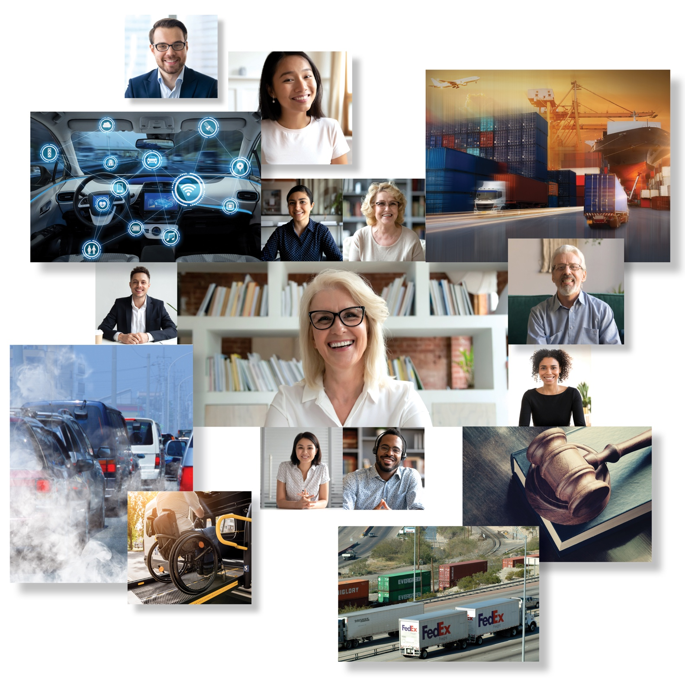
Leadership. Service. Responsibility.
Master of Engineering Degree for Transportation Professionals
Dr. Kevin Womack
Program Manager
Texas A&M Transportation Institute
kevin-womack@tti.tamu.edu
(435) 375-8923
tti.tamu.edu/master

Slide 3
Leadership. Service. Responsibility.
Master of Engineering Degree for Transportation Professionals
About Our Program
Online degree
Developed by transportation experts at TTI
Administered by Department of Multi-disciplinary Engineering, College of Engineering, Texas A&M University
Focuses on topics that are necessary for managers and/or policy and decision makers in the transportation community.

Slide 4
Leadership. Service. Responsibility.
Master of Engineering Degree for Transportation Professionals
About Our Program
All coursework, no research project or report
Students will be part of a 2 year cohort
Classes to begin Fall of 2022
Application deadline is June 1, 2022
Master of Engineering in Engineering, Transportation

Slide 5
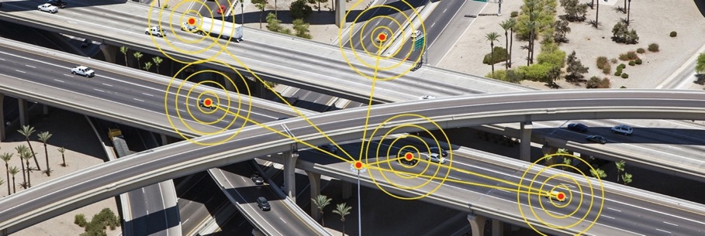
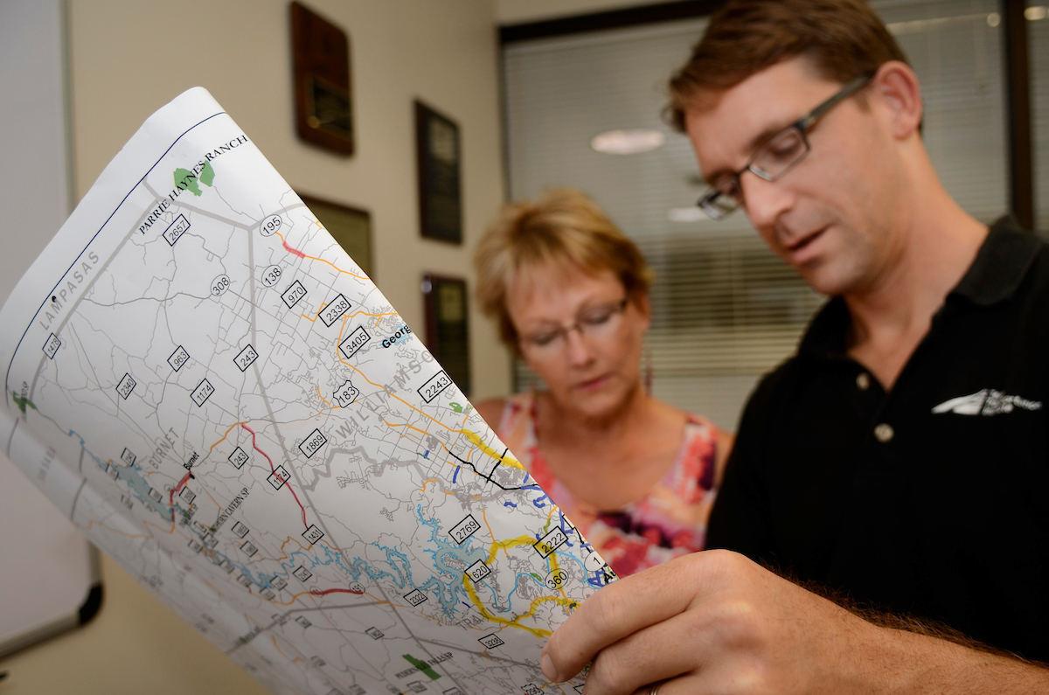
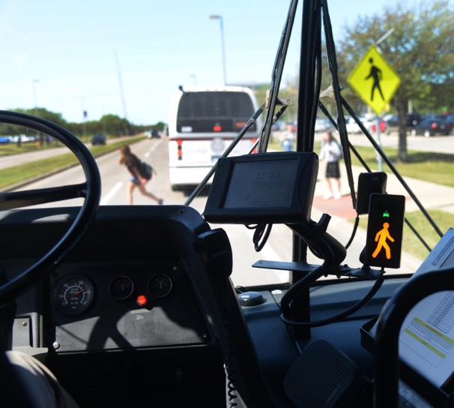
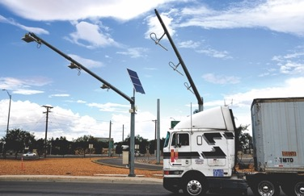
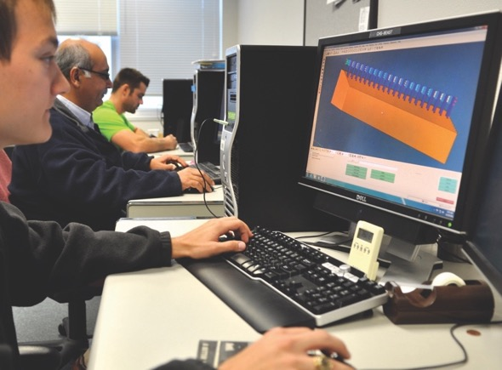
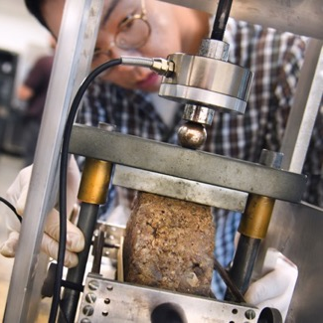
Learn from experts in the field

Slide 6
Leadership. Service. Responsibility.
Master of Engineering Degree for Transportation Professionals
Nine courses, three credits per course
Two courses first fall semester
Two courses first spring semester
One course summer semester
Two courses plus capstone second fall semester
Two courses plus capstone second spring semester
Capstone project over the second year, 2 credits fall, 1 credit spring
30 Total credit hours

Slide 7
Leadership. Service. Responsibility.
Master of Engineering Degree for Transportation Professionals
Degree program designed specifically for transportation professionals that are in management or want to be managers.
Focus on issues relevant to management of transportation entities rather than technical topics.
Individual courses designed using input from TTI Advisory Council members.
Courses are to be taught by transportation experts at TTI, credentialed as faculty in Department of Multi-disciplinary Engineering.

Slide 8
Leadership. Service. Responsibility.
Master of Engineering Degree for Transportation Professionals
Criteria for Curriculum Development
Avoid overlap with CEE’s Master of Science in Civil Engineering focused on transportation.
Service a unique niche not currently being addressed.
Maximize use of TTI talent, minimize need to use adjuncts.

Slide 9
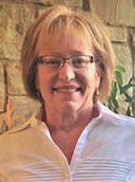
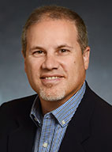
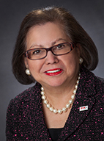
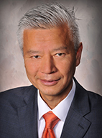
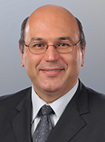
Leadership. Service. Responsibility.
Master of Engineering Degree for Transportation Professionals
Gayle Akins
PMO Director and Austin Site Leader, Neology Inc.
Al Alonzi
Texas Division Administrator, Federal Highway Administration (FHWA)
Esperanza “Hope” Andrade
Chair, VIA Metropolitan Transit Board of Directors
Dan Chen
Vice President and General Manager, 3M Transportation Safety Division
Dimitris Lagoudas
Senior Associate Vice Chancellor for Engineering Research, Texas A&M University System Deputy Director, Texas A&M Engineering Experiment Station

Slide 10
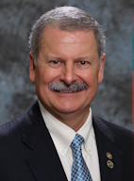
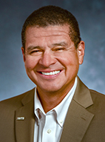
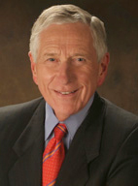
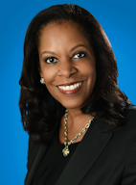
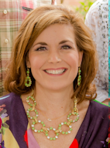
Leadership. Service. Responsibility.
Master of Engineering Degree for Transportation Professionals
Bob Lanham
President, Williams Brothers Construction Co., Inc.
Carlos Lopez
HNTB, Regional Business Development Leader
Drayton McLane
Chairman, McLane Group
Sandra Phillips Rogers
Group Vice President, General Counsel, Chief Legal Officer, and Corporate Secretary, Toyota Motor North America, Inc.
Jennifer Woodard
Executive Vice President, Associated General Contractors of Texas

Slide 11
Leadership. Service. Responsibility.
Master of Engineering Degree for Transportation Professionals
Suggested Topics for Coursework
Communication – Internal and External to Organization
Selecting and Adopting New Technologies
Leadership and Team Building
Policy
Connected and Automated Vehicles
Manage Flow of Work Products and Projects
Goal Setting and Strategic Thinking
Performance Metrics – Organization and System
Cybersecurity
Working with Regulatory Agencies
Credit Markets and Finance

Slide 12
Leadership. Service. Responsibility.
Master of Engineering Degree for Transportation Professionals
Suggested Topics for Coursework
Environmental Issues and Stewardship
Eco-System of Transportation Providers
Legal Issues
Logistics – Supply Chain, Block Chain
Social Media
Decision Making Processes
Role of Transportation System to Economy
Multi-Modal Freight Interface
Interdisciplinary Interactions
Innovation – Multi-Modal Solutions

Slide 13
Leadership. Service. Responsibility.
Master of Engineering Degree for Transportation Professionals
Program Course Titles
Leadership for Transportation Professionals
Transportation Organizational Management
Transportation and the Economy
Communication for Transportation Professionals
Selection and Adoption of New Transportation Technologies
Sustainable Transportation and the Environment
Transportation Policy
Regulatory and Legal Topics in Transportation
Innovation in Transportation Funding and Finance
Capstone Project I and II

Slide 14
First Year Courses
MTDE 660 | Leadership for Transportation Professionals
Overview of theories and best practices of leadership at all levels of an organization; five core practices of exemplary leadership: model the way, inspire a shared vision, challenge the process, enable others to act, and encourage the heart; adoption of an outward mindset to improve performance, spark collaboration, and accelerate innovation.
MTDE 661 | Transportation Organizational Management
Current practice and practical tools for leaders and aspirational leaders of transportation organizations; practices and processes for mission-critical areas; managing flow of work products/projects; decision-making processes; interdisciplinary interaction with planners, property owners, developers and government agencies; project development and execution; organizational performance metrics and transportation system performance.
MTDE 662 | Transportation and the Economy
Relationship between transportation modes and local, regional, national and international economic systems; history of the relationship between economic growth and development and the transportation system; role of different modes and intermodal facilities and transportation development; vulnerabilities in transportation and economic systems; trends in financing transportation systems; application of blockchain and other technologies to the movement of goods.
MTDE 663 | Communication for Transportation Professionals
Exploration of effective communication fundamentals; the concepts of strategic thinking and storytelling; use of verbal, printed and electronic media in communicating transportation information; the set of modern professional behavior for excelling in the workforce among peers and clients.

Slide 15
Summer Course
MTDE 664 | Selection and Adoption of New Transportation Technologies
Innovative transportation solutions and societal impacts; connected and automated vehicles; demise of the internal combustion engine and rise of electrification; communication with travelers and vehicles; intelligent roadway infrastructure; smart sensor data fusion with artificial intelligence; cybersecurity and communications spectrum; tools for public agencies building the future of transportation.

Slide 16
Second Year Courses
MTDE 665 | Sustainable Transportation and the Environment
Sustainable transportation as the nexus of transportation and the environment; human environment and socioeconomic issues relevant to transportation and the natural environment of ecological issues relevant to transportation; environmental legislation affecting the transportation infrastructure development process; emerging environmental topics, such as resilience and public health.
MTDE 666 | Transportation Policy
Fundamentals of policy tools in transportation; strategic policy development; transportation governance, laws and regulations; transportation policy in relation to economics, funding, finance and modal usage; linkages between urban development, transportation systems and policy levers; policy issues associated with the relationship between transportation and global drivers of change; role of the transportation leader in strategic policy development.
MTDE 667 | Regulatory and Legal Topics in Transportation
Legal and regulatory matters relevant to planning, developing, constructing and maintaining transportation facilities; local, state, and federal transportation laws and regulations; legal matters, types of unforeseen questions, and dispute resolution options arising in the life cycle of a transportation project; role of legal counsel and effective interactions with counsel.
MTDE 668 | Innovation in Transportation Funding and Finance
Transportation funding and finance at the federal and state levels for all modes of transportation; funding process, financing strategies, innovative funding options and associated risks; role of funding in project planning and prioritization; measuring return on transportation investment; role of various governmental agencies in the funding process; shifting policies and issues that impact funding.

Slide 17
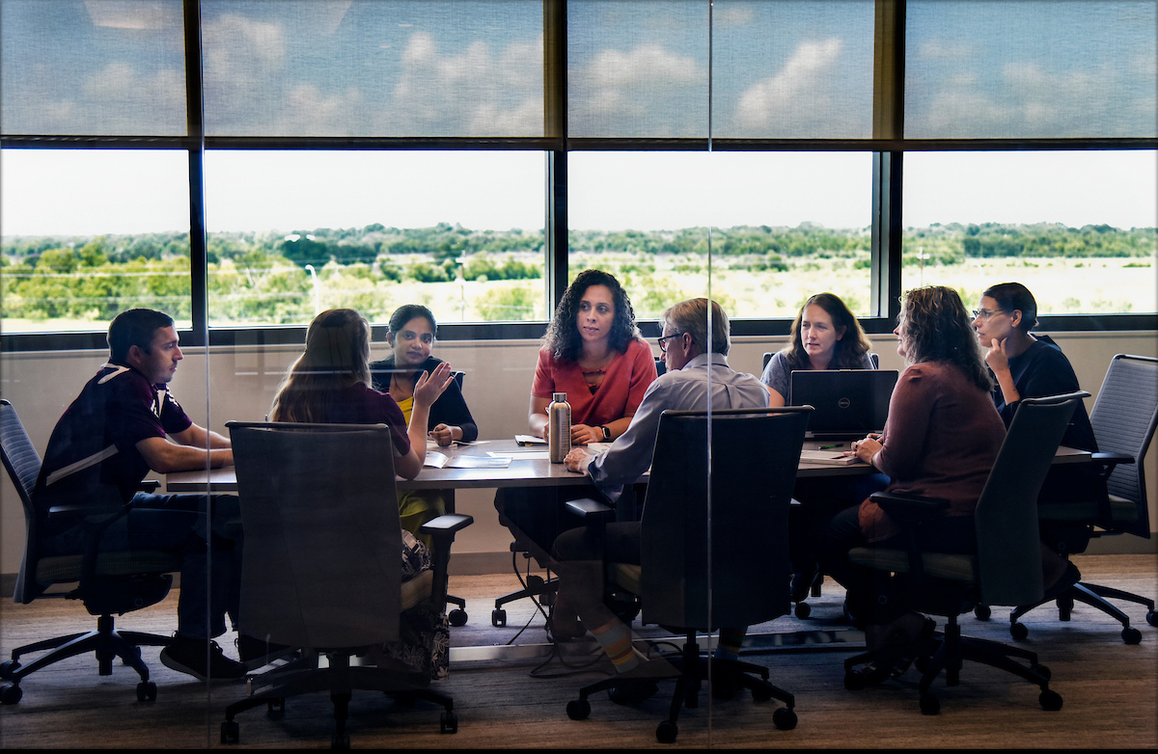
Second-Year Capstone Courses
MTDE 669 | Transportation Capstone I
First-semester course in a two-semester capstone project sequence; project selection; development of problem statement; review of literature relevant to problem; proposal to address problem including analysis methodology and data collection plan; mid-project presentation at end of semester.
MTDE 670 | Transportation Capstone II
Second-semester course in a two-semester capstone project sequence; continuation of project started in first semester; project scoping; data analysis; development of options, recommendations and implementation approaches; formal presentation of final results to stakeholder audience at end of semester.

Slide 18
Leadership. Service. Responsibility.
Master of Engineering Degree for Transportation Professionals
Earn your Aggie Ring
Graduate in the spring semester of the second year

Slide 19
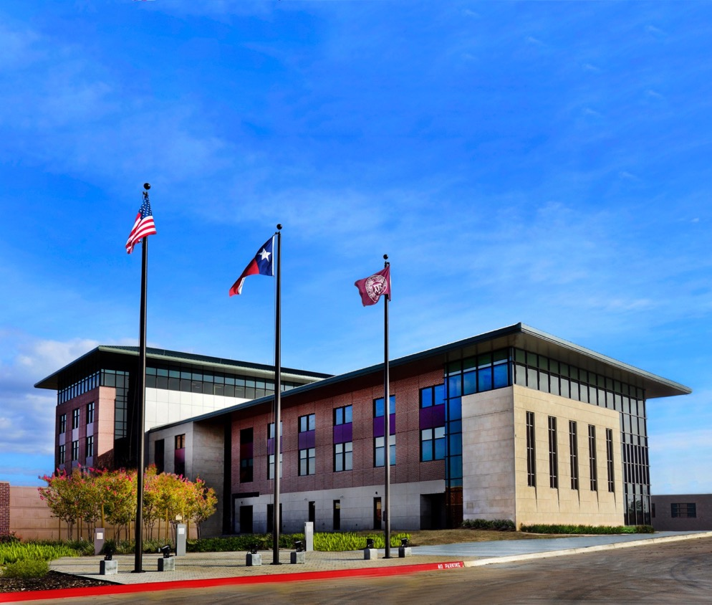
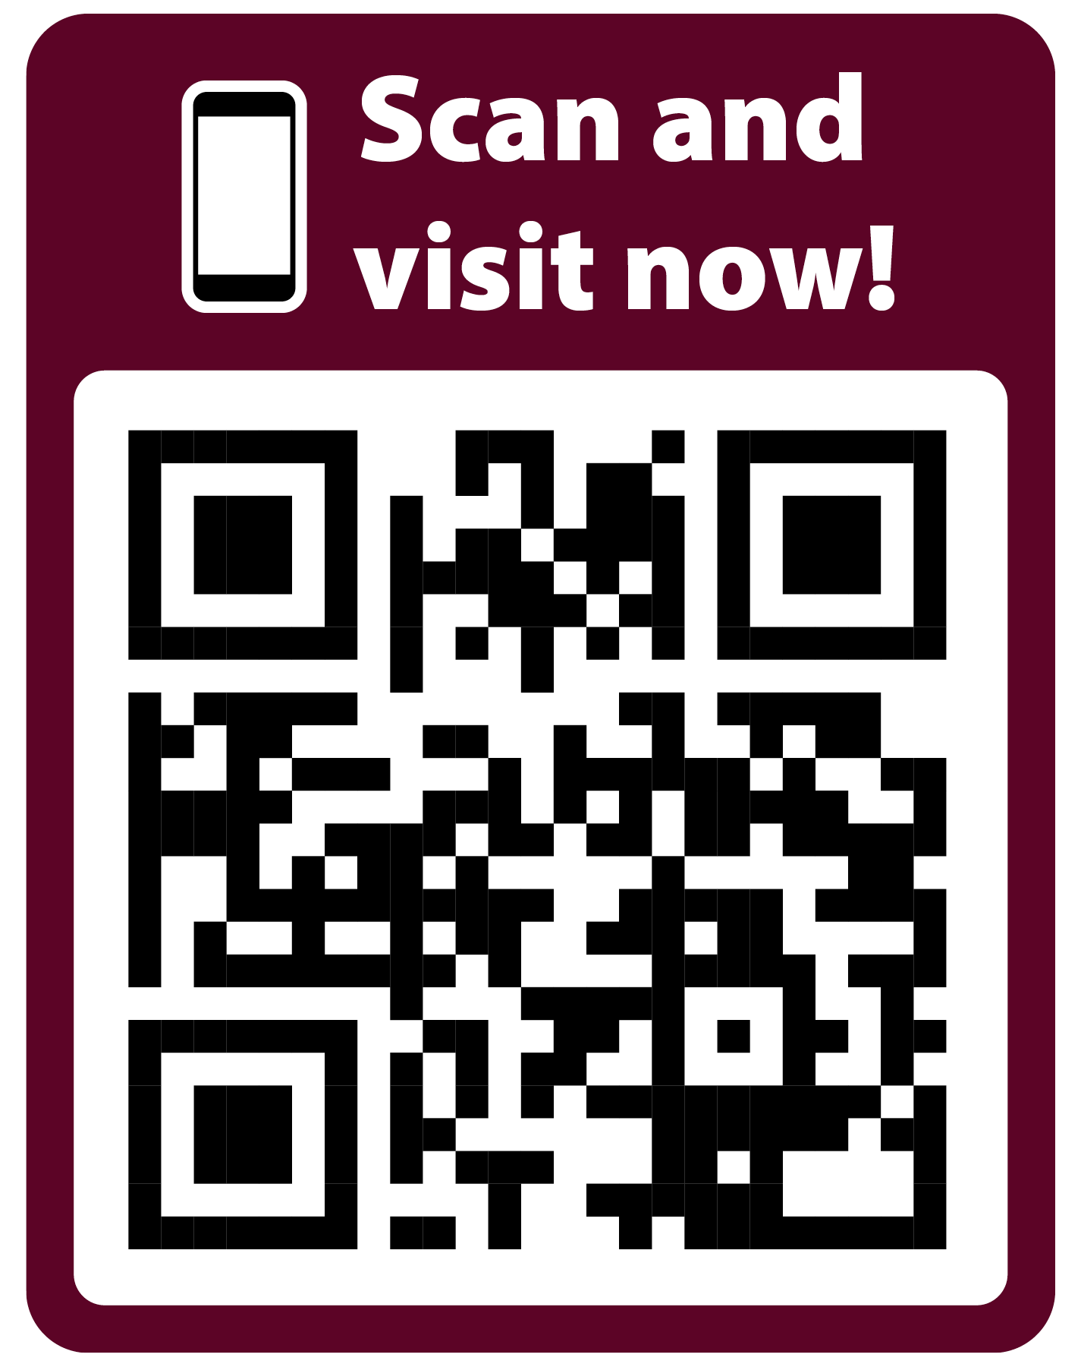
For more information on the online Master of Engineering degree for transportation professionals, visit tti.tamu.edu/master.
Master of Engineering Degree for Transportation Professionals
Dr. Kevin Womack
Program Manager
Texas A&M Transportation Institute
kevin-womack@tti.tamu.edu
(435) 375-8923
Follow us on social media
Leadership. Service. Responsibility.
19

