Slide 1
I-345 Feasibility Study Update
Ceason Clemens, P.E.
Dallas Deputy District Engineer
August 13, 2021

Slide 2
I-345 Overview
I-345 Overview
Connects I-45 to the south and US 75 to the north
Approx 1.5 miles long
Mostly bridge structure
180,000 vehicles per day

Slide 3
I-345 Study Goals

Slide 4
2019 Public Meeting Summary
KEY TAKEAWAY
There was a pretty even three-way split for public preference on alternatives to evaluate in the feasibility study. More than 70% of respondents suggested further analysis of the alternatives presented in the 2016 CityMap Study.

Slide 5
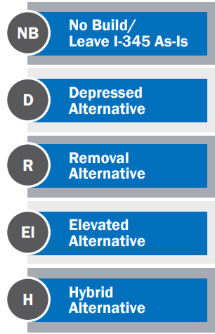
Developing Alternatives
Using public and stakeholder feedback & coordination with City of Dallas, NCTCOG and DART, TxDOT developed 5 conceptual alternatives

Slide 6
No Build/Leave I-345 As-Is
NO BUILD/LEAVE I-345 AS-IS
No additional improvements would occur to the existing I-345 other than maintenance.

Slide 7
Depressed Alternative
DEPRESSED ALTERNATIVE
Similar to US 75
Mainlanes are low and cross streets over the top
Discontinuous frontage roads
City street grid is enhanced
Bike & pedestrian facilities along frontage roads & local streets

Slide 8
Removal Alternative
REMOVAL ALTERNATIVE
Existing mainlanes would be removed
City street grid is enhanced
Bike & pedestrian facilities along local streets

Slide 9
Elevated Alternative
ELEVATED ALTERNATIVE
Similar to what exists now
Smaller footprint
Aesthetic improvements, revised access & signage for drivers
Enhanced city street grid
Bike & pedestrian facilities under the highway

Slide 10
Hybrid Alternative
HYBRID ALTERNATIVE
Similar to US 75 & proposed depressed alternative
Limited access from the mainlanes to local streets
No frontage roads
Access to the area is from local streets, I-30 or Woodall Rodgers
Street grid & bike/ped is enhanced

Slide 11
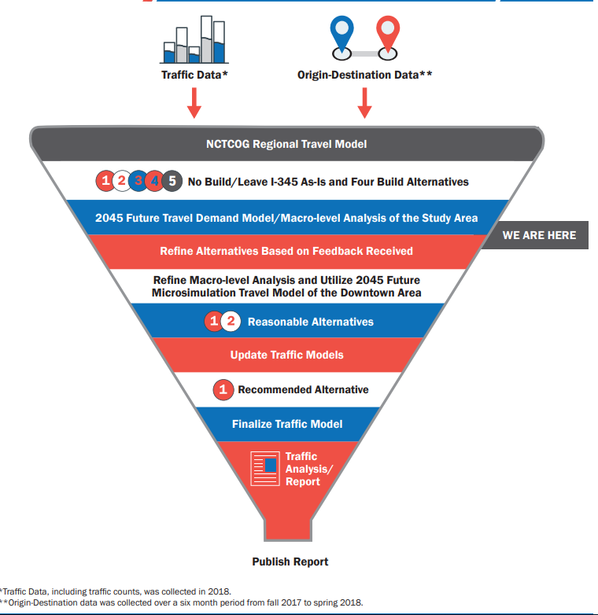
Traffic Demand Approach
How we analyze traffic data for each alternative and the process for refining alternatives

Slide 12
Traffic Study Area
TRAFFIC STUDY AREA
Green=Macro Traffic Model Limits; bounded by I-635, I-20 and Loop 12
Blue=Micro Traffic Model Limits; downtown area
*Allows TxDOT to determine origin & destination information

Slide 13
Origin & Destination Traffic Data
Origin & Destination Overview
O&D is needed to understand travel patterns of I-345 users; where they’re coming from and going to
Data purchased from StreetLight
Data collected within the green study area bounded by I-635, I-20 & Loop 12 at points along mainlanes, ramps and cross streets
Collected from fall 2017 to spring 2018; includes weekday and weekend data

Slide 14
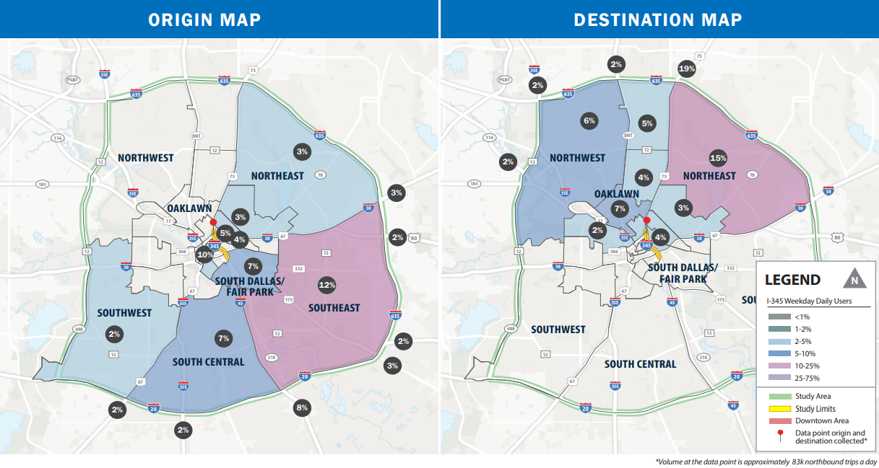
Origin & Destination Traffic Data- Thru Traffic Northbound I-345

Slide 15
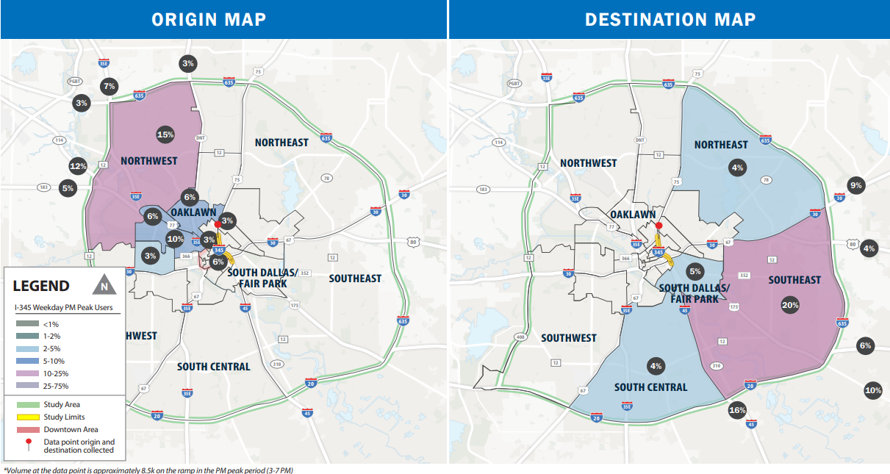
Origin & Destination Traffic Data- Eastbound Woodall to Southbound I-345

Slide 16
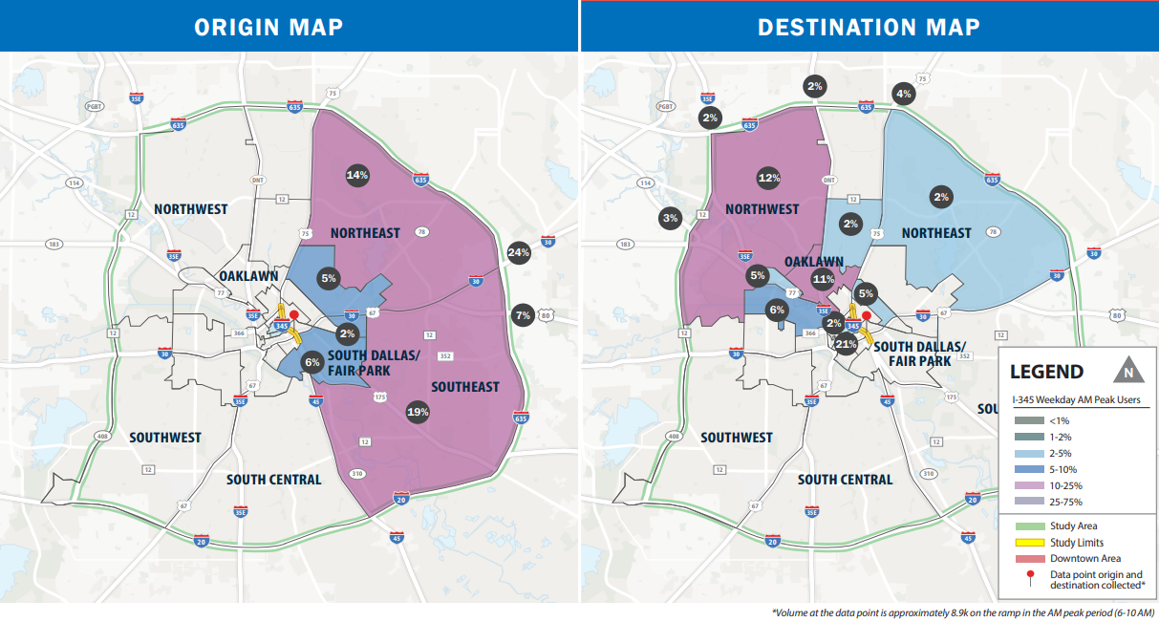
Origin & Destination Traffic Data- Westbound I-30 to Northbound I-345

Slide 17
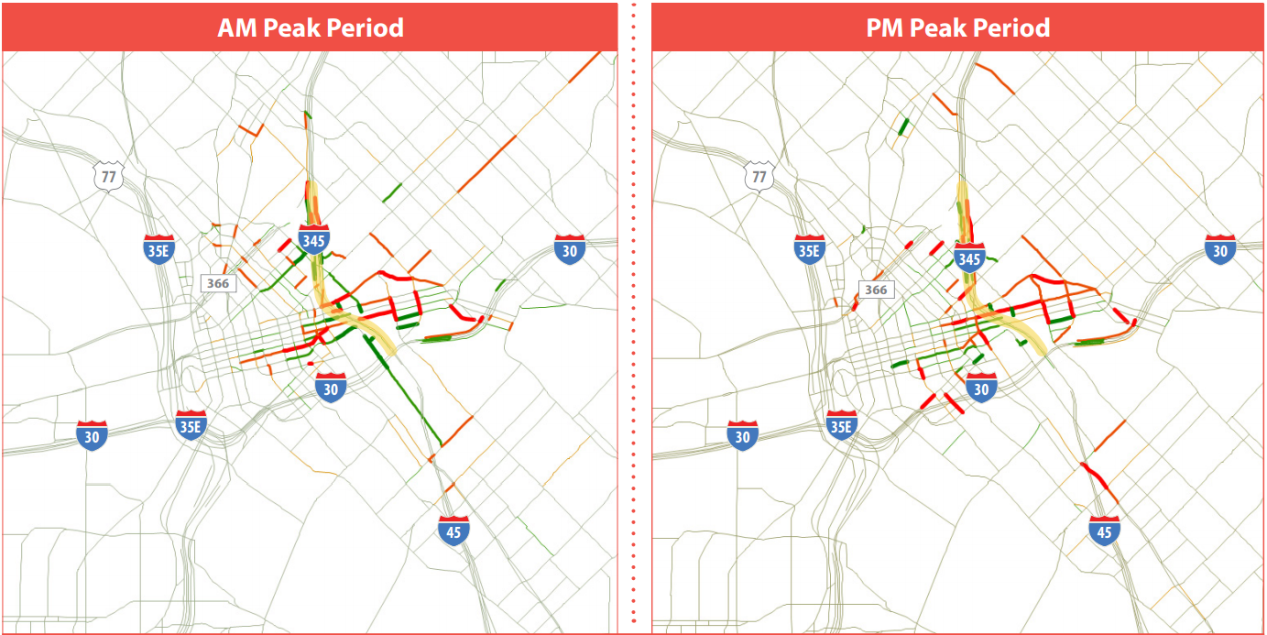
Where does the traffic go? Depressed Alternative
Key Takeaway: Red shows an increase in traffic volumes. Green shows a decrease in traffic volumes. Due to the changes in access with the depressed alternative, traffic patterns will change traffic volumes on various roadways.

Slide 18
Where does the traffic go? Removal Alternative
Key Takeaway: With the freeway connection removed, traffic patterns will change and traffic volumes on the local roads are anticipated to increase.

Slide 19
Where does the traffic go? Elevated Alternative
Key Takeaway: Due to changes in access with the elevated alternative, traffic patterns will change traffic volumes on various roadways.

Slide 20
Where does the traffic go? Hybrid Alternative
Key Takeaway: Due to changes in access with the hybrid alternative, traffic patterns will change traffic volumes on various roadways.

Slide 21
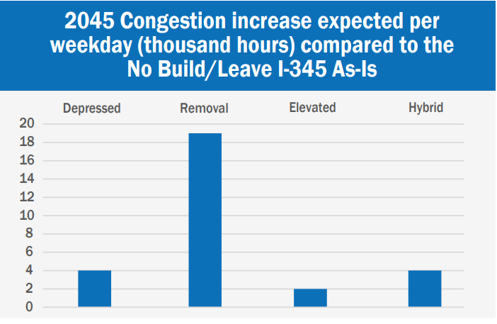
2045 Regional Model Summary
Key Traffic Takeaways
The Depressed, Elevated and Hybrid alternatives add additional hours of congestion per weekday compared to the No Build due to changes in access to and from the freeway.
The Removal alternative adds a significant amount of additional hours of congestion per weekday compared to the No Build due to the elimination of the freeway connection from I-30 to Woodall Rodgers Freeway.

Slide 22
Alternatives Screening Process-Evaluation Matrix
How is TxDOT evaluating the conceptual alternatives?
Utilizing an evaluation matrix to objectively compare each alternative to the No Build alternative
Evaluation criteria based off study goals, stakeholder feedback and public involvement
EVALUATION MATRIX CRITERION
Mobility
Connectivity
Economic Development
Construction Cost
Sustainability

Slide 23
Public Meeting Materials/Survey/Comments
345STUDY.COM
Comment deadline is August 22

Slide 24
Questions?
Questions?
Melissa Meyer
TxDOT Dallas District
345study@txdot.gov
345study.com
Photo courtesy of Christopher Mann

