Slide 1

Identifying Pedestrian Safety Risks Through Systemic Crash Analysis
Wesley Kumfer, PhD, RSP1
TexITE Greater Dallas and Fort Worth Sections

Slide 2

Overview
Why do we need a systemic safety approach?
How do we measure safety?
How is a systemic approach different?
What countermeasures can we use?
How have State DOTs used systemic safety approaches?

Slide 3
Introduction
Tell me about yourself
Are you in public or private practice?
Do you consider yourself a planner, an engineer, or something else?
Do you measure transportation safety as part of your job?
If so, what method(s) do you use?

Slide 4
Introduction
Relevant projects and reports:
  NCHRP 893: Systemic Pedestrian Safety Analysis
  Implementing Safe Systems in the United States: Guiding Principles and Lessons from International Practice
  A Safe System-Based Framework and Analytical Methodology for Assessing Intersections
  NCHRP 17-87: Guide to Pedestrian Analysis
  Shaping the narrative around traffic injury: A media framing guide for transportation and public health professionals

Slide 5
Why do we need a systemic safety approach?

Slide 6
Pedestrian Safety Trends
From 2009 to 2018, pedestrian fatalities in the United States increased by 53%.
  All other traffic fatalities increased over that same period by only 2%.
  In 2018, pedestrian fatalities accounted for 17% of all traffic fatalities, despite low share of miles of travel and project funds.
  The share of SUV-involved pedestrian fatalities during that time rose by 81%.
In 2019, the projected number of pedestrian fatalities rose to a 30-year high of 6,590.
Source: Retting, 2020

Slide 7
Pedestrian Safety Trends
Findings are similar in Texas.
In 2019, there were:
  5,975 crashes involving pedestrians
  1,317 serious injuries
  669 deaths
This was an 18% increase from 2015 to 2019
Pedestrians now account for 20% of all traffic fatalities in Texas
Source: TxDOT, 2020

Slide 8

Pedestrian Safety Trends
Pedestrian deaths on our roadways have far outpaced fatalities in all other modes, yet pedestrian safety improvements continue to be underfunded.
We still tend to think of safety outcomes as the product of individual behaviors and rational decisions.
There are four Vision Zero Cities in Texas (Austin, San Antonio, Houston, and Laredo), and Vision Zero cannot be achieved if pedestrians are not provided the same level of safety as motorists.

Slide 9
How do we measure safety?

Slide 10
The Traditional Approach
The traditional transportation safety management system tends to rely on “hot spot” (high crash location) identification.
While this approach is important, there are several limitations:
  A hot spot approach is inherently reactive and based on crash history.
  Pedestrian crashes may be rare or widely dispersed across a network, making a hot spot approach unreliable and cost-ineffective.
  Crash risk factors for pedestrians may be different than for motor vehicles.
  The process needs to be tailored to data related to pedestrians, and to provide guidance on how to gather needed data.
We need a method to identify locations of risk.

Slide 11
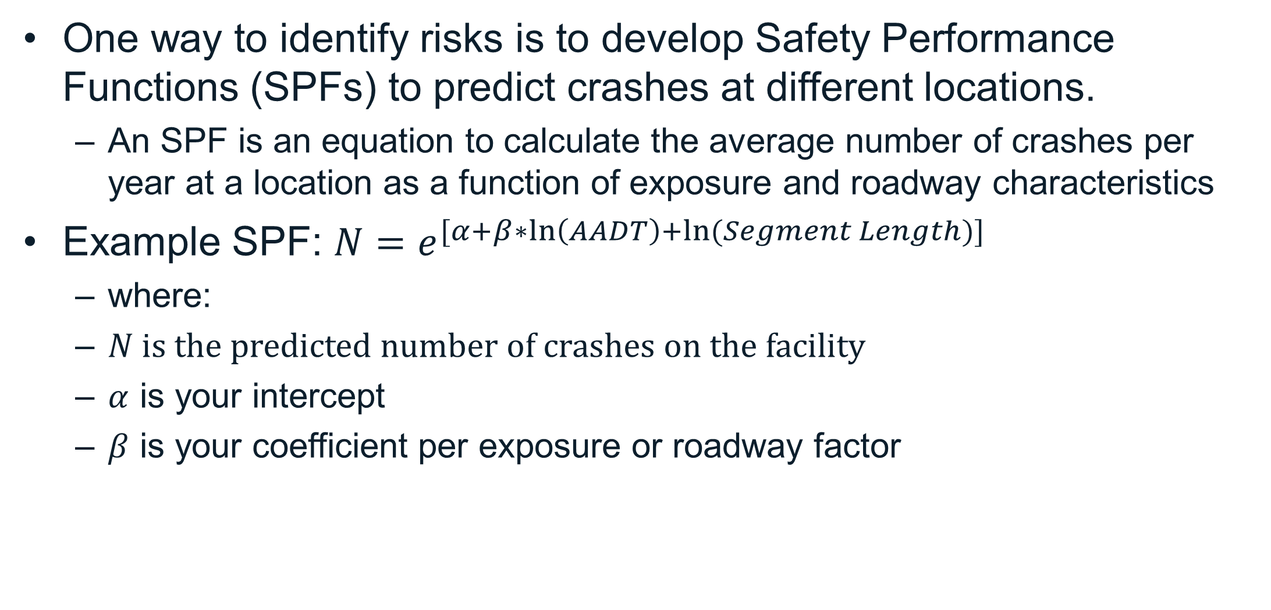
Safety Performance Functions
One way to identify risks is to develop Safety Performance Functions (SPFs) to predict crashes at different locations.
  An SPF is an equation to calculate the average number of crashes per year at a location as a function of exposure and roadway characteristics
Example SPF: $N=e^{[α+β∗\ln\left(AADT\right)+ln⁡(Segment Length)]}$
  where:
  $N$ is the predicted number of crashes on the facility
  $α$ is your intercept
  $β$ is your coefficient per exposure or roadway factor
Source: AASHTO, 2010

Slide 12
Safety Performance Functions or Crash Rates?
Why use SPFs instead of crash rates?
  Crash rates fluctuate significantly with changes in traffic volume or roadway elements.
  There is an assumed linear relationship between traffic volumes and crash rates.
  Crash rates can tell us little about the safety effects of roadway features.
  Crash rates are not always comparable between facility types.
SPFs can be used in network screening and further refined with historic crash data to determine expected crashes.

Slide 13
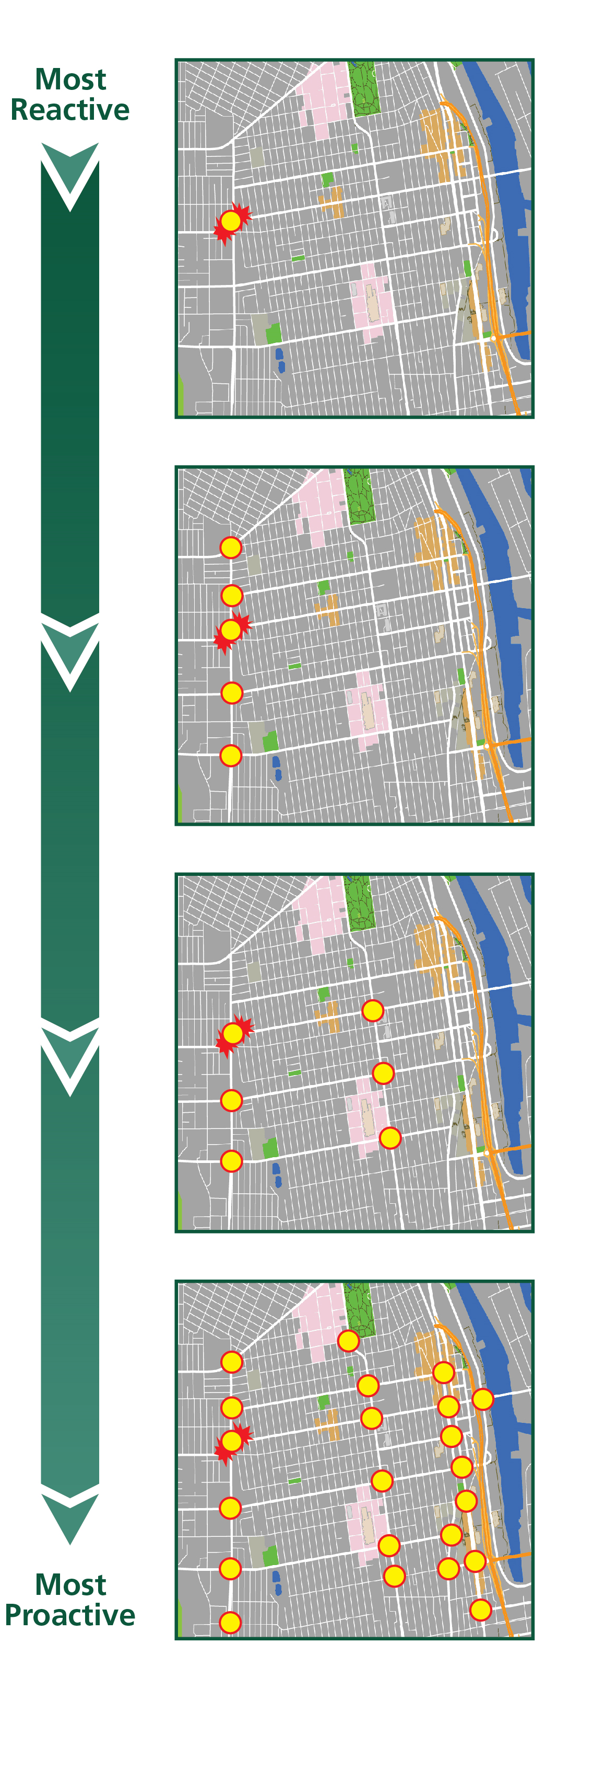
A Risk-Based Approach
The systemic approach is an effective tool for identifying locations of risk proactively.
  Identifies a safety concern based on an evaluation of data at the system (or network) level.
  Establishes common characteristics (risk factors) of locations where severe crashes occur.
  Emphasizes low-cost safety countermeasures to address the risk factors for high severity types of crashes.
  Prioritizes locations across the entire roadway network where treatable risk factors are present, with or without a prior crash history.
Source: NCHRP Report 893

Slide 14
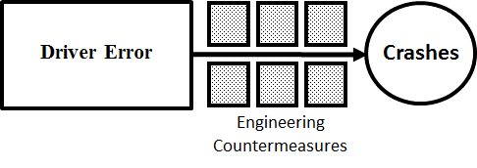
Examining Risk
Systemic approaches can help us better understand where latent risks exist in our transportation network.
If we only focus on hot spots, we might fall into the temptation of only attempting to address driver error.
The roadway environment, however, is full of dormant risks that produce and exacerbate driver errors to cause crashes.
Source: Dumbaugh et al., 2019

Slide 15
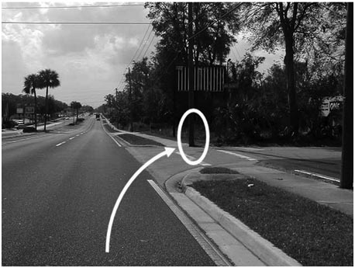
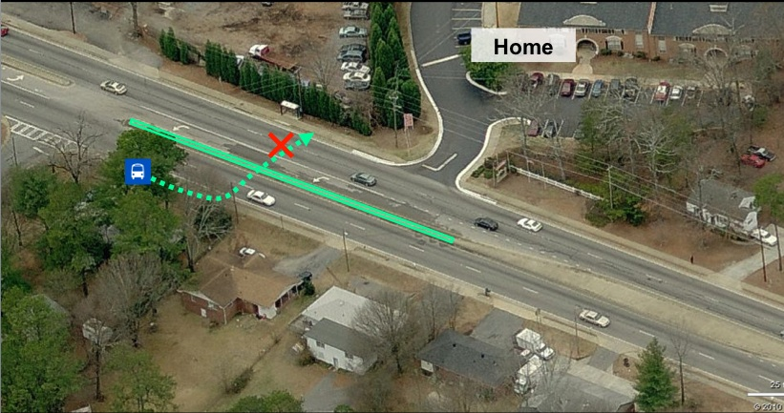
Examining Risk
Rather than merely react to these latent risks after crashes have already occurred, we can use systemic approaches to identify locations that produce risks for pedestrians and then treat suites of risks with engineering countermeasures.
Source: Snyder, 2011
Source: Dumbaugh et al., 2019

Slide 16
How is a systemic approach different?

Slide 17
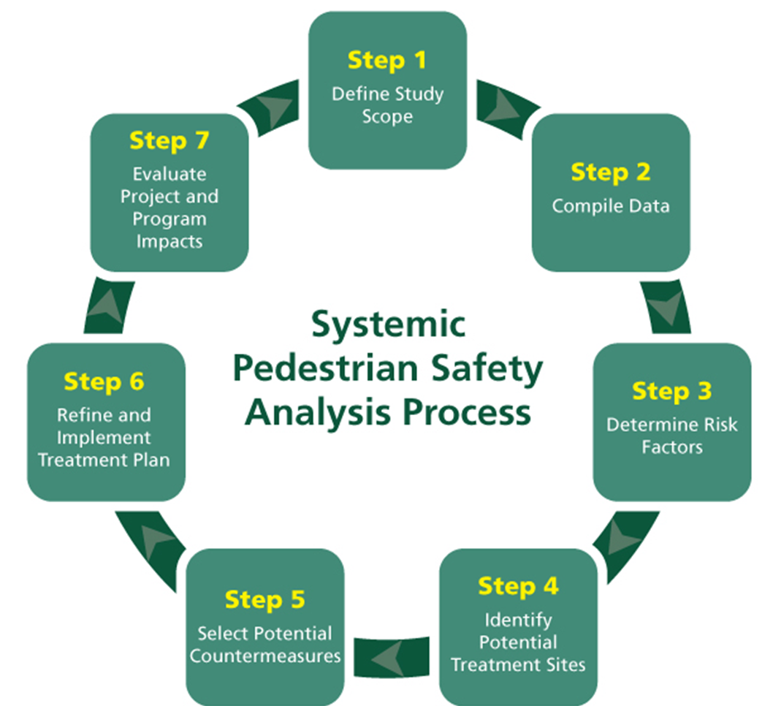
The Systemic Approach
Seven-step process
Source: NCHRP Report 893

Slide 18
Step 1: Define Study Scope
For NCHRP Report 893, we looked at:
Two types of crashes modeled on 23,636 segments in City of Seattle
  Crashes between vehicles traveling straight and pedestrians crossing at street segments – 802 crashes in data
  All crashes between vehicles and pedestrians at street segments at night – 404 crashes in data
Crash data from 2007-2014
Variables to capture risks inherent to roadway design, traffic volumes, population characteristics, and development types/density

Slide 19
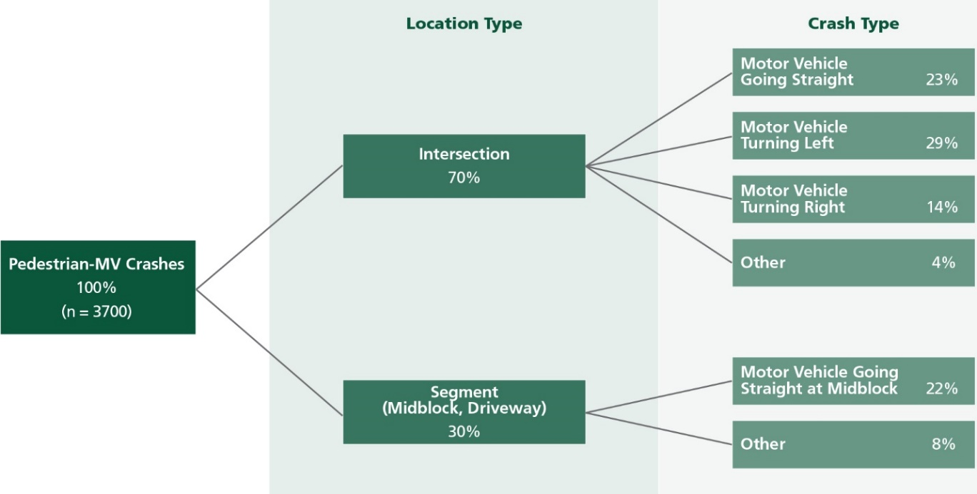
Step 1: Define Study Scope
Seattle starts with a crash tree to identify the most important crash types to address.
Source: NCHRP Report 893; City of Seattle Bicycle and Pedestrian Safety Analysis, 2016

Slide 20
Step 2: Compile Data
Compile crash data, exposure (volume) data, roadway data, and context data
Source: NCHRP Report 893

Slide 21
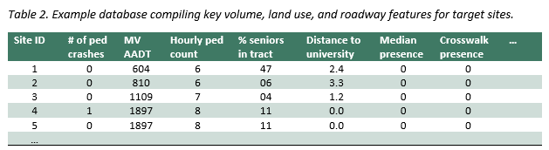
Step 2: Compile Data
Compile the data into a single database with entries per segment.
Source: NCHRP Report 893

Slide 22
Step 3: Determine Risk Factors
We developed new SPFs for both crash types.
Two modeling steps
  Conditional random forest regression
    Modeling procedure to identify most important variables with crash predictive power
Negative Binomial regression
  Only the statistically significant variables retained in models
  Best fitting models (based on AIC and BIC) chosen between variable sets with different transformations

Slide 23
Step 3: Determine Risk Factors
Statistically significant variables (p<0.05)
Exposure Measures and Activity surrogates – scale measures * | MV Straight Through struck pedestrian crossing at segment | All types MV struck ped. at Night - segments
MV VOLUME 1 - ADA AADT estimate log-transformed | + | n.s.
MV VOLUME 2 - RF Regression Estimate of AADT – scaled /10,000 | n.s. | +
BUS Traffic - No. of buses stopping within 150 feet | + | +
Pedestrians Walking Along the segment (AADP raw estimate) | + | +
Pedestrians Walking Along the segment (AADP log) | − | −
Mean income area residents / 10,000 | − | −
Commercial density within 1/10 mi | + | +
Light pole density (no. per mile) | + | +
Source: Kumfer et al., 2019

Slide 24
Step 3: Determine Risk Factors
Statistically significant variables (p<0.05)
Roadway and Built Environment – categorical variables* | MV Straight Through struck pedestrian crossing at segment | All types MV struck ped. at Night - segments
Speed Limit 30 or 35 compared to 25 | n.s. | +
4 or 5 plus through lanes compared to 1 lane | + | n.s.
Two-way continuous left turn lane | + | +
One or two striped on-street parking lanes (compared to no striped parking) | + | n.s.
Dedicated right turn lane at either adjacent intersection | + | n.s.
Marked midblock crosswalk (one or more) | + | +
One-way traffic flow | n.s. | −
Urban village designation (increasing intensity/uses) | + | +
Source: Kumfer et al., 2019

Slide 25
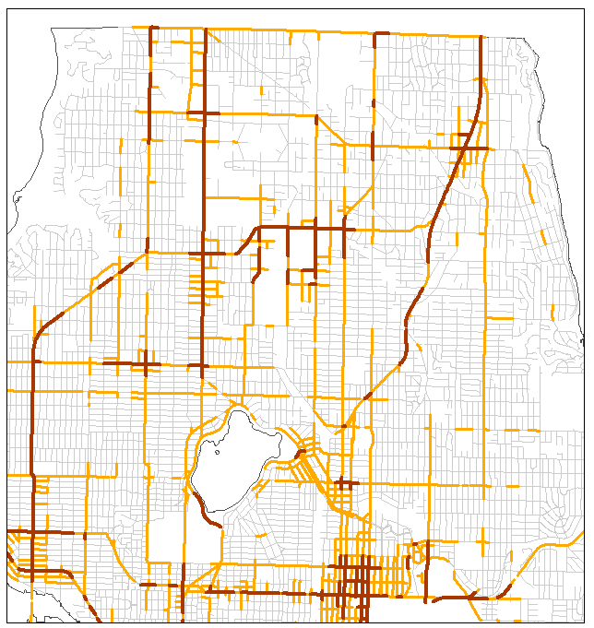
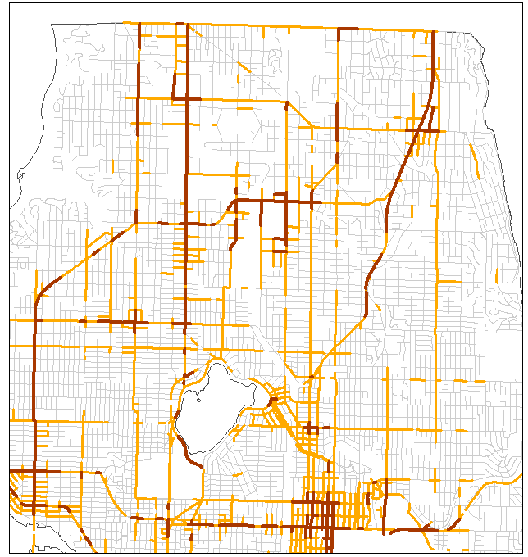
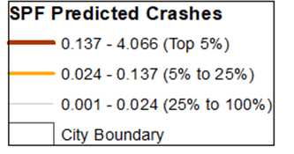
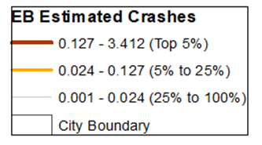
Step 4: Identify Potential Treatment Sites
We worked with the City of Seattle to map our results.
Segments ranked based on two criteria
  Screening based on predicted crash risk (SPF-predicted crashes)
  Screening based on risk factors
Source: Kumfer et al., 2019

Slide 26
Step 4: Identify Potential Treatment Sites
Review of potential countermeasures to pedestrian risk.
Suitable for Signalized Intersections Only (or where signal is added) | Suitable for Unsignalized Locations Only (midblock or intersection) | Suitable for Either Signalized or Unsignalized Crossing Locations (including midblock)
• Leading pedestrian interval • Longer pedestrian phase • Restricted left turn (protected crossing phase) | • In-roadway yield-to-pedestrian (R1-6) sign/gateway • Advance stop/yield bar and R1-5/5a sign • Pedestrian hybrid beacon (sometimes called a HAWK signal) | • High visibility crosswalk • Traffic calming (raised device) • Median crossing island • Reduce number of lanes road diet • Curb extension and parking restriction • Location-specific lighting improvement
Source: NCHRP Report 893

Slide 27
What countermeasures can we use?

Slide 28
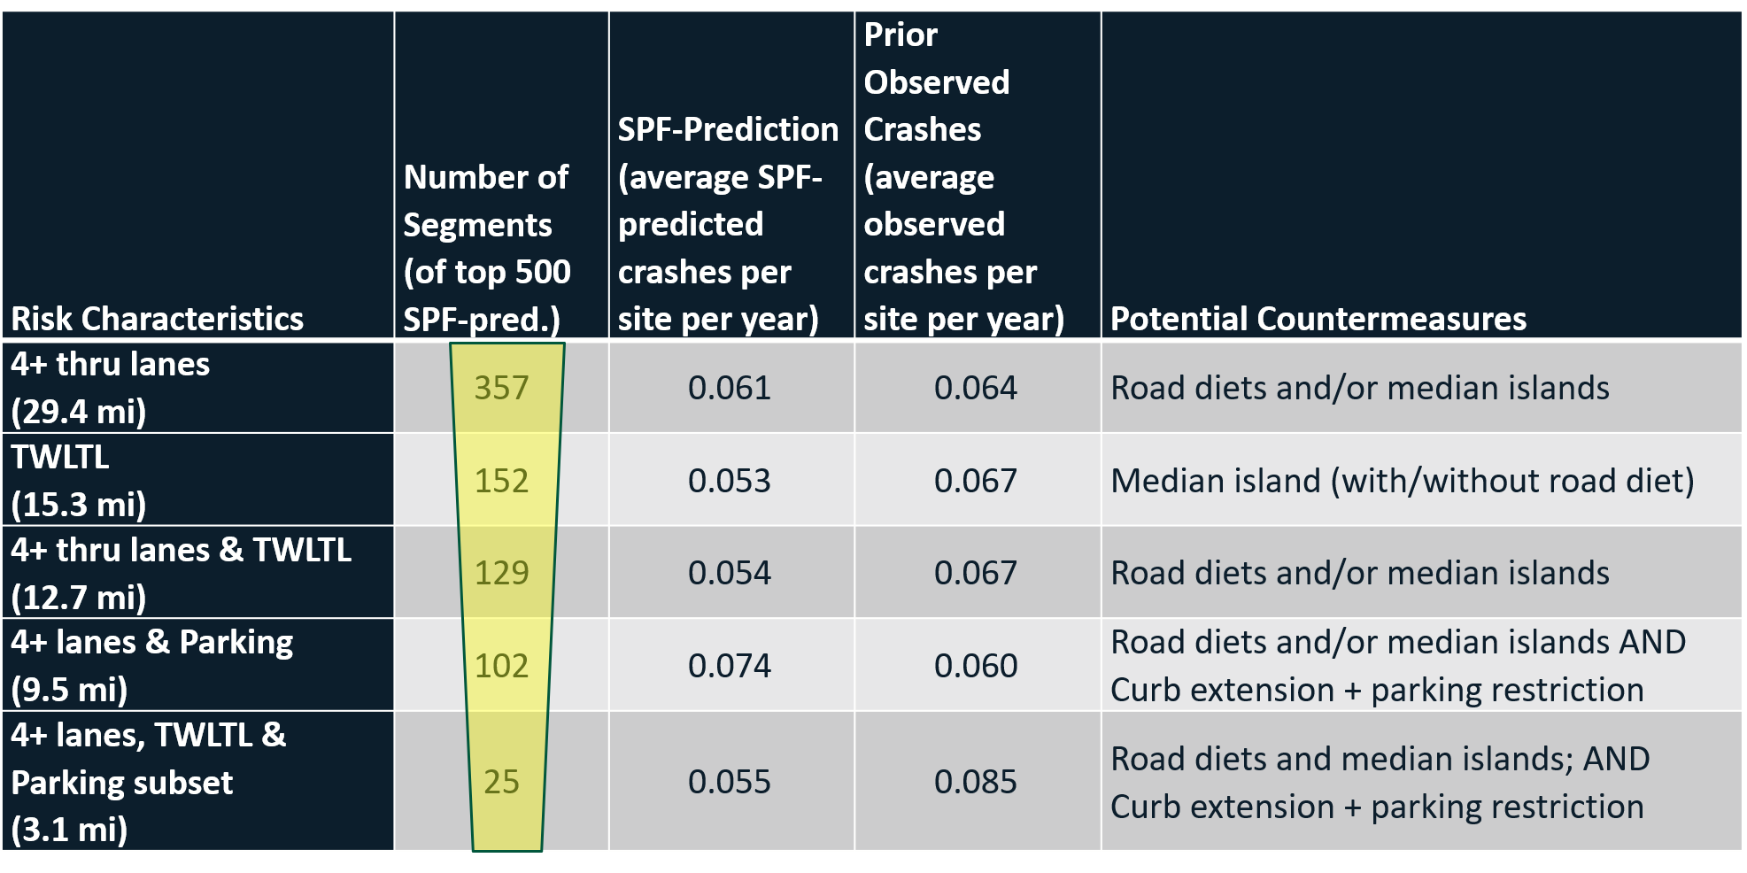
Step 5: Select Potential Countermeasures
Countermeasures can be selected based on ranking by known risk factors, matched with relevant treatments
Source: Kumfer et al., 2019

Slide 29
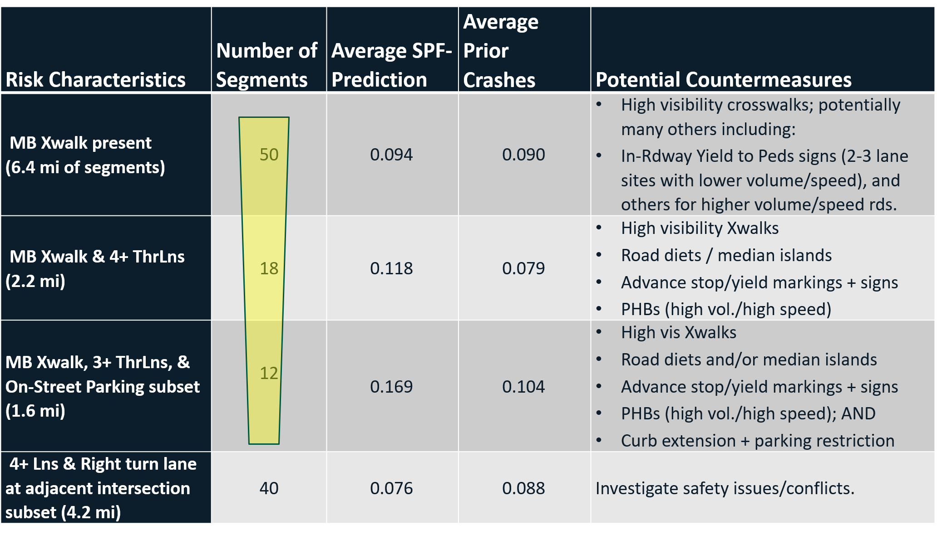
Step 5: Select Potential Countermeasures
Countermeasures can be selected based on ranking by known risk factors, matched with relevant treatments
Source: Kumfer et al., 2019

Slide 30
Consider the Safe Systems Approach
Pedestrians are far more susceptible to the kinetic energy that is released in a crash, so countermeasures should:
  Separate these users in space
  Separate these users in time
  Manage speeds and mass heterogeneity when separation is not possible
  Anticipate human error
Source: ITE, 2019

Slide 31
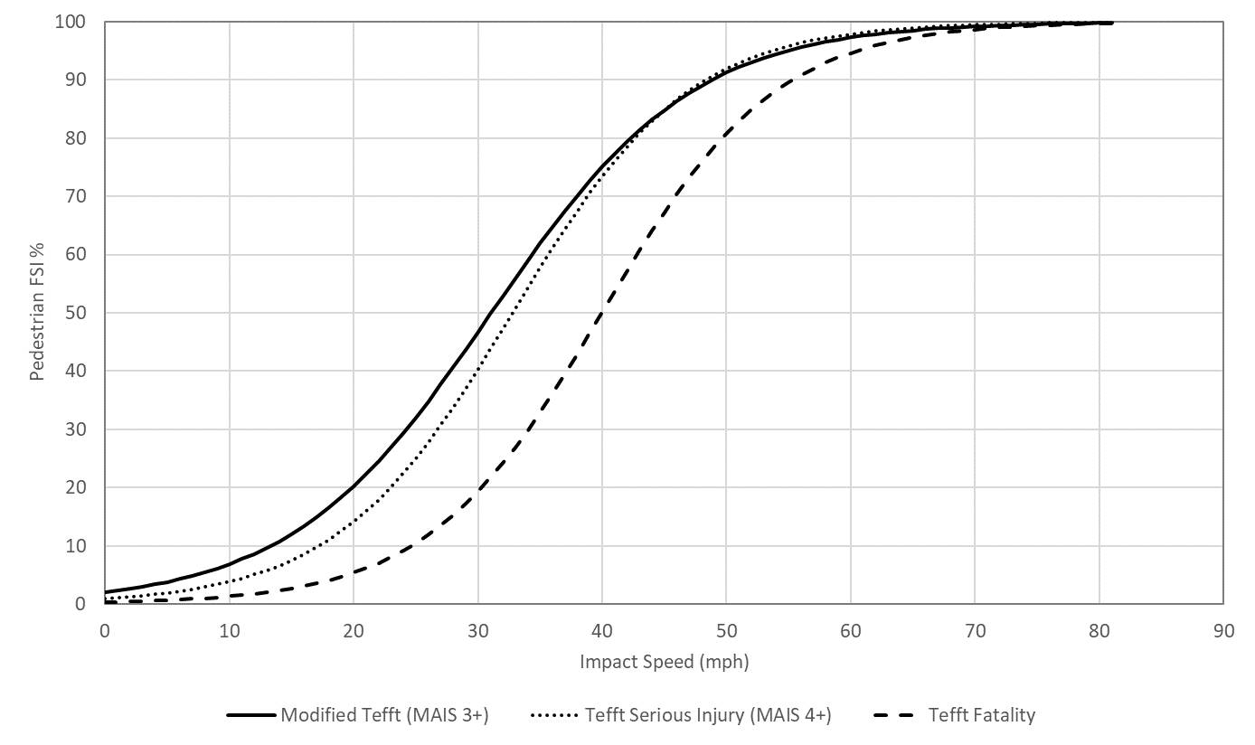
Kinetic Energy and Pedestrians
Why is kinetic energy so important for pedestrians?
Impact Speed (mi/h) | Risk of Fatality (percent)
24-33 | 10
33-41 | 25
41-48 | 50
48-55 | 75
54-63 | 90
Source: Sanders et al., 2019
Vehicle Speed (mph) | Probability of pedestrian fatality (%) | Probability of pedestrian fatality age ≤ 14 (%) | Probability of pedestrian fatality age 15 to 59 (%) | Probability of pedestrian fatality age ≥ 60 (%)
20 | 5 | 1 | 1 | 3
30 | 45 | 5 | 7 | 62
40 | 85 | 16 | 22 | 92
Source: Porter et al., forthcoming
Source: Donnell et al., 2009

Slide 32
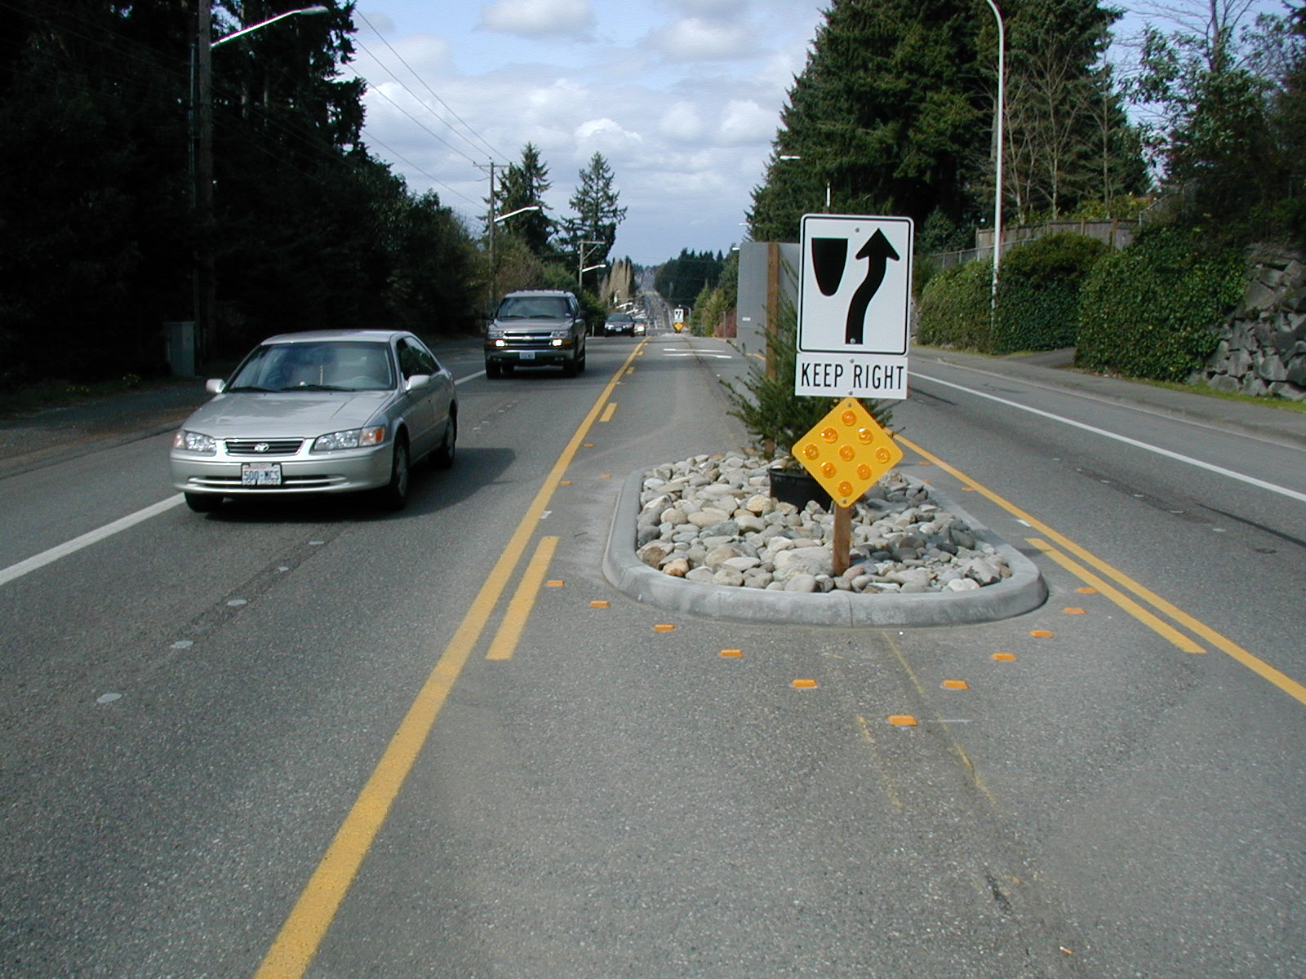
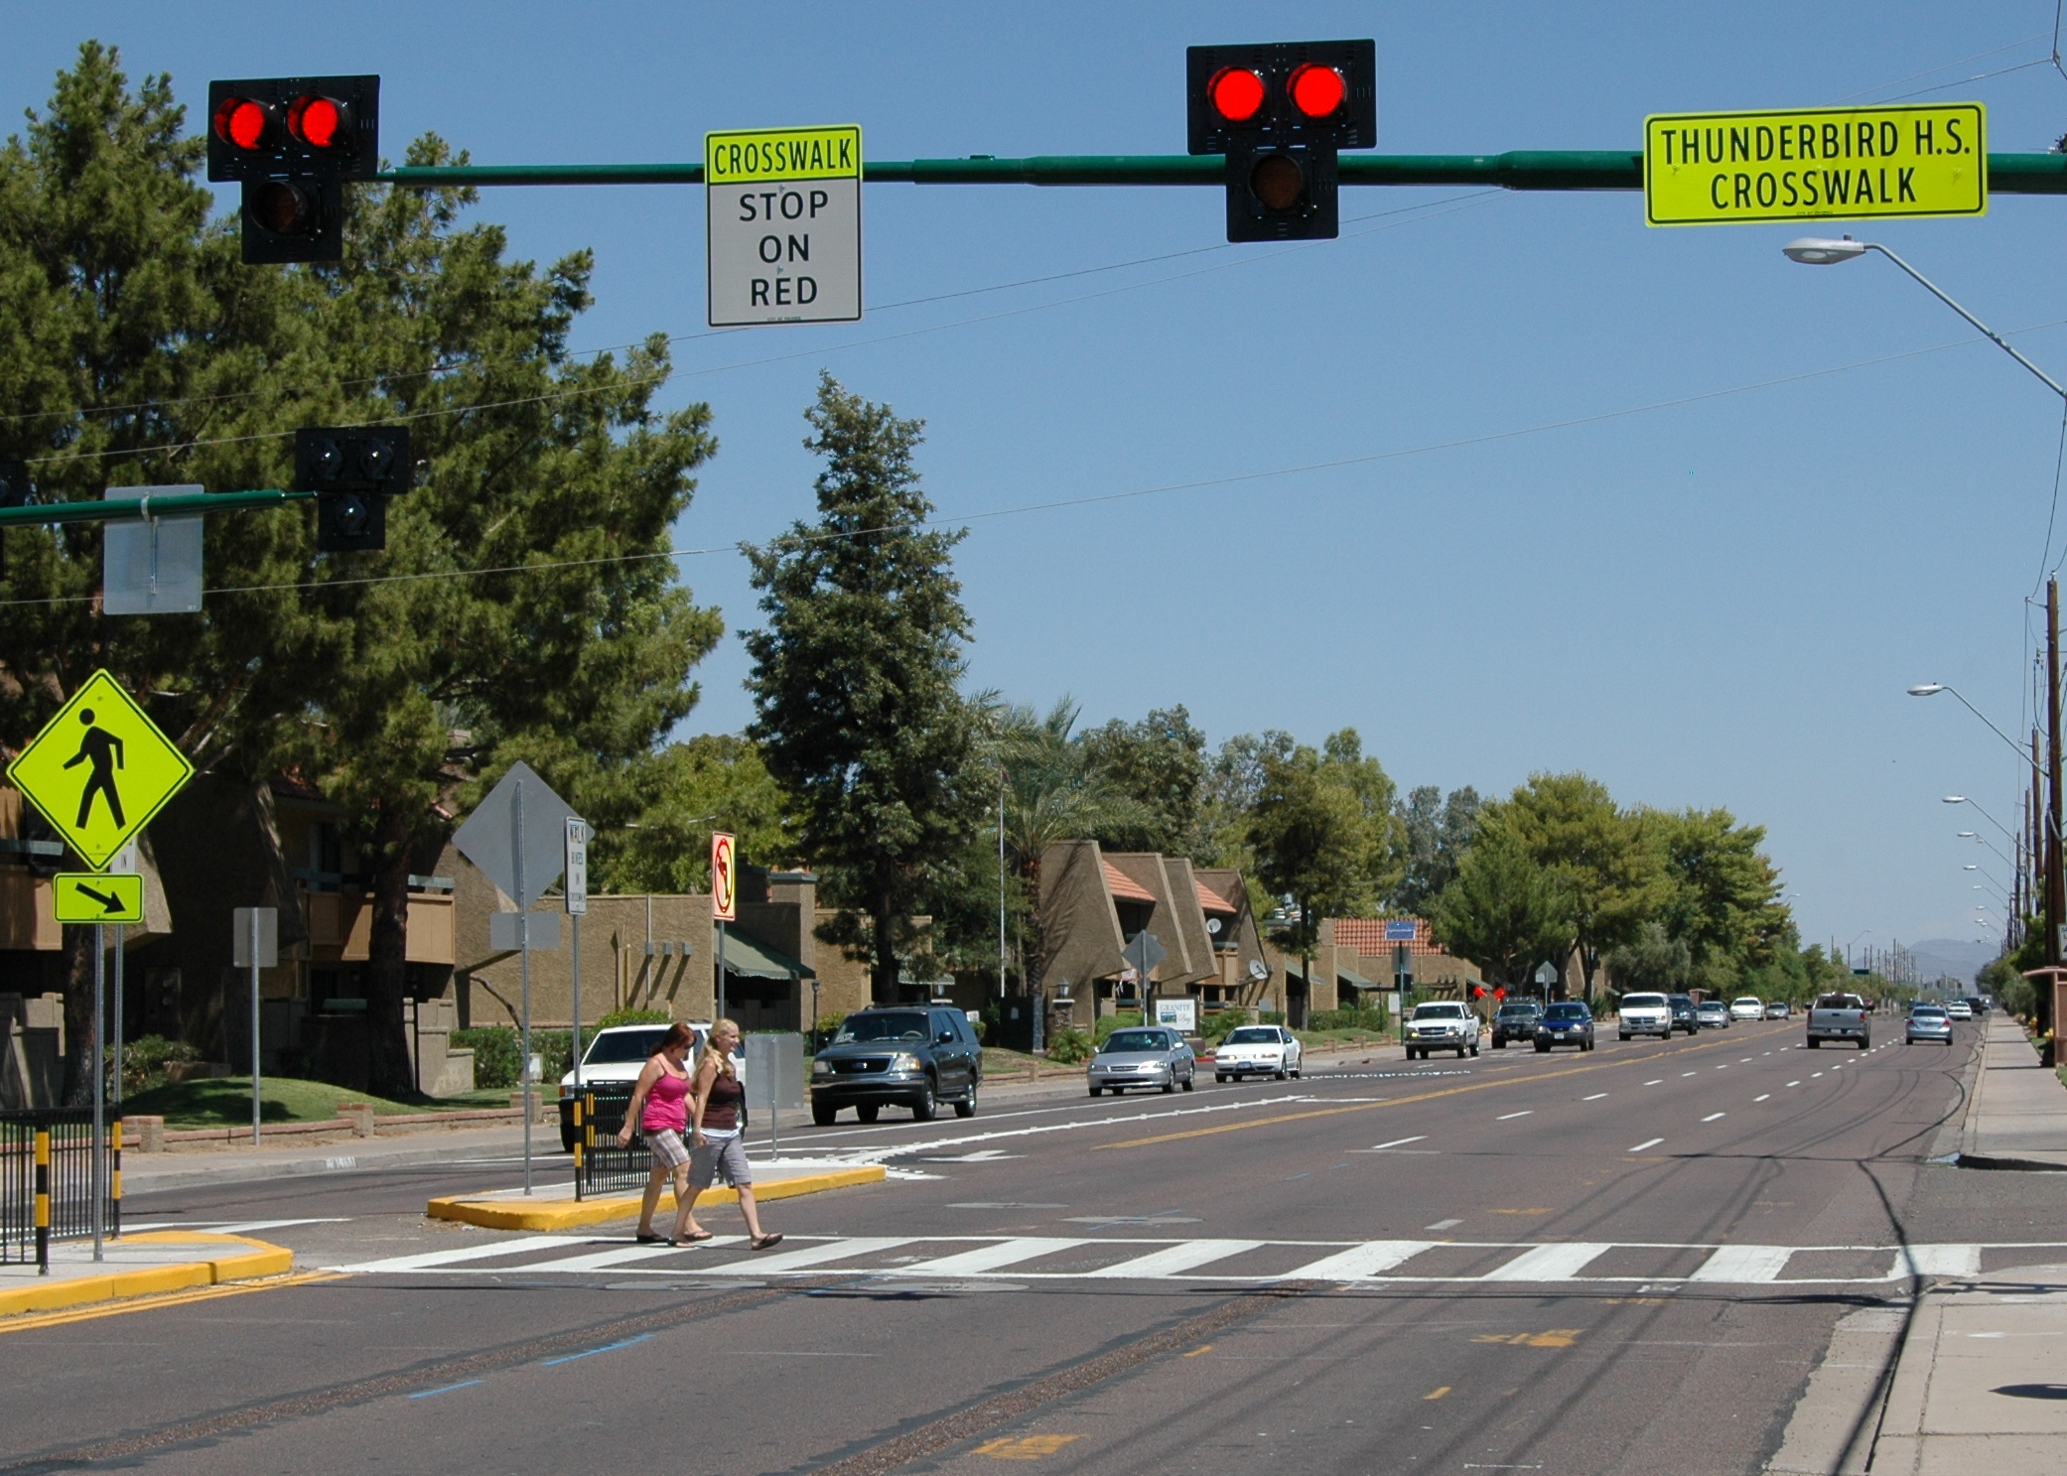
Managing Kinetic Energy
Systemic treatments can fit into a Safe System
Road diets for speed management
Pedestrian hybrid beacons for separation in time
Photo credit: Dan Burden
(pedbikeimages.org)
Photo credit: Mike Cynecki
(pedbikeimages.org)

Slide 33
Steps 6 and 7: Refine and Evaluate
Steps 6 (Refine and Implement Treatment Plan) and 7 (Evaluate Project and Program Impacts) were beyond our research project but are critical steps.
Step 6 might be where agencies use a benefit/cost ratio or some other measure to determine which sites to treat.
Step 7 is critical to ensure that risks have been properly addressed. You should still collect data after the treatment has been installed.
Step 7 is also important to evaluate the equitable distribution of safety interventions. You can make the biggest gains in safety in locations that have been traditionally underserved.

Slide 34
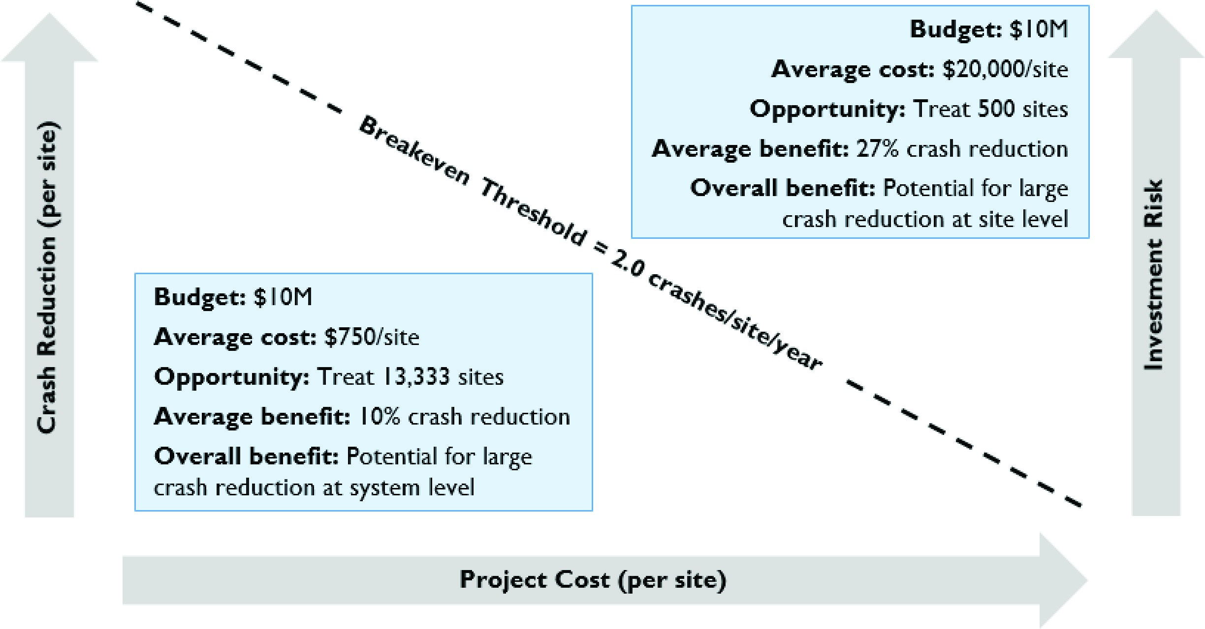
Project Prioritization
The goal is to prioritize effective treatments to address the most severe crashes.
Source: Gross et al., 2016

Slide 35
How have State DOTs used systemic safety approaches?

Slide 36
Numerous Examples
NCHRP Report 893 lists several case studies based on different levels of data collection and statistical proficiency.
Since its publication, more states have adopted various systemic safety approaches, often as part of Vision Zero or Toward Zero Death initiatives.
  FHWA has hosted a series of webinars on doing systemic cost analysis as part of the Focus on Reducing Rural Roadway Departures series.
Systemic safety approaches fit into Strategic Highway Safety Plans and can be used to justify the creation of new warrants.

Slide 37
Oregon DOT
ODOT’s All Roads Transportation Safety program splits its available funding (primarily Highway Safety Improvement Program funds) evenly between two project prioritization types:
  Hotspot treatments
  Systemic analyses further disseminated into three emphasis areas
    Roadway departure
    Intersection
    Pedestrian/bicycle safety improvement projects
  Together, these three emphasis areas account for approximately 90 percent of the fatal and injury crashes in Oregon.

Slide 38
Oregon DOT
ODOT has a less data-intensive approach that relies on an expert panel to weight risks.
Source: NCHRP Report 893

Slide 39
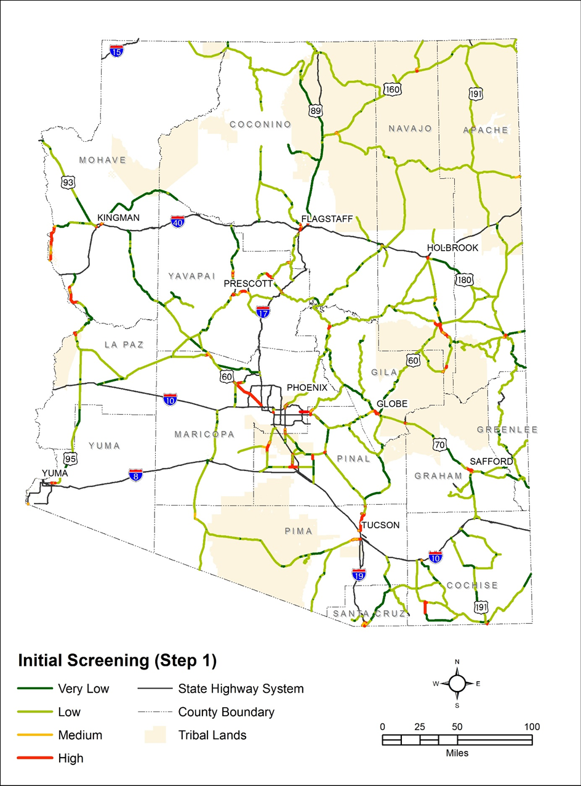
Arizona DOT
ADOT used a less data-intensive approach that relied on past research to assign weights to pedestrian risk factors.
For example:
  Width of Roadway
    6-Lane Highway = 6 points
    4- or 5-Lane Undivided Highway = 3 points
    2- or 3-Lane Undivided Highway = 2 points
    2- or 3-Lane Divided Highway = 1 point
  Posted Travel Speed
    >45 miles-per-hour (mph) = 6 points
    35 to 45 mph = 4 points
    25 to 35 mph = 2 points
    <25 mph = 0 points
Source: Kimley Horn et al., 2017

Slide 40
Conclusions
Our roadway environments contain many risks for pedestrians.
Pedestrian crashes are widely dispersed, so identifying treatment locations can be difficult.
A systemic, risk-based approach can be useful for leveraging crash, exposure, and context data to uncover sites for treatment.
Achieving a safe system requires us to be proactive in addressing risks.

Slide 41
Acknowledgments
I’d like to thank my colleagues and the co-authors of our TRB paper on Report 893
  Libby Thomas
  Laura Sandt
  Bo Lan
Also thanks to Chad and Brian for the invitation!

Slide 42
Questions?
Feel free to contact me at:
Kumfer@hsrc.unc.edu

